Slide 1
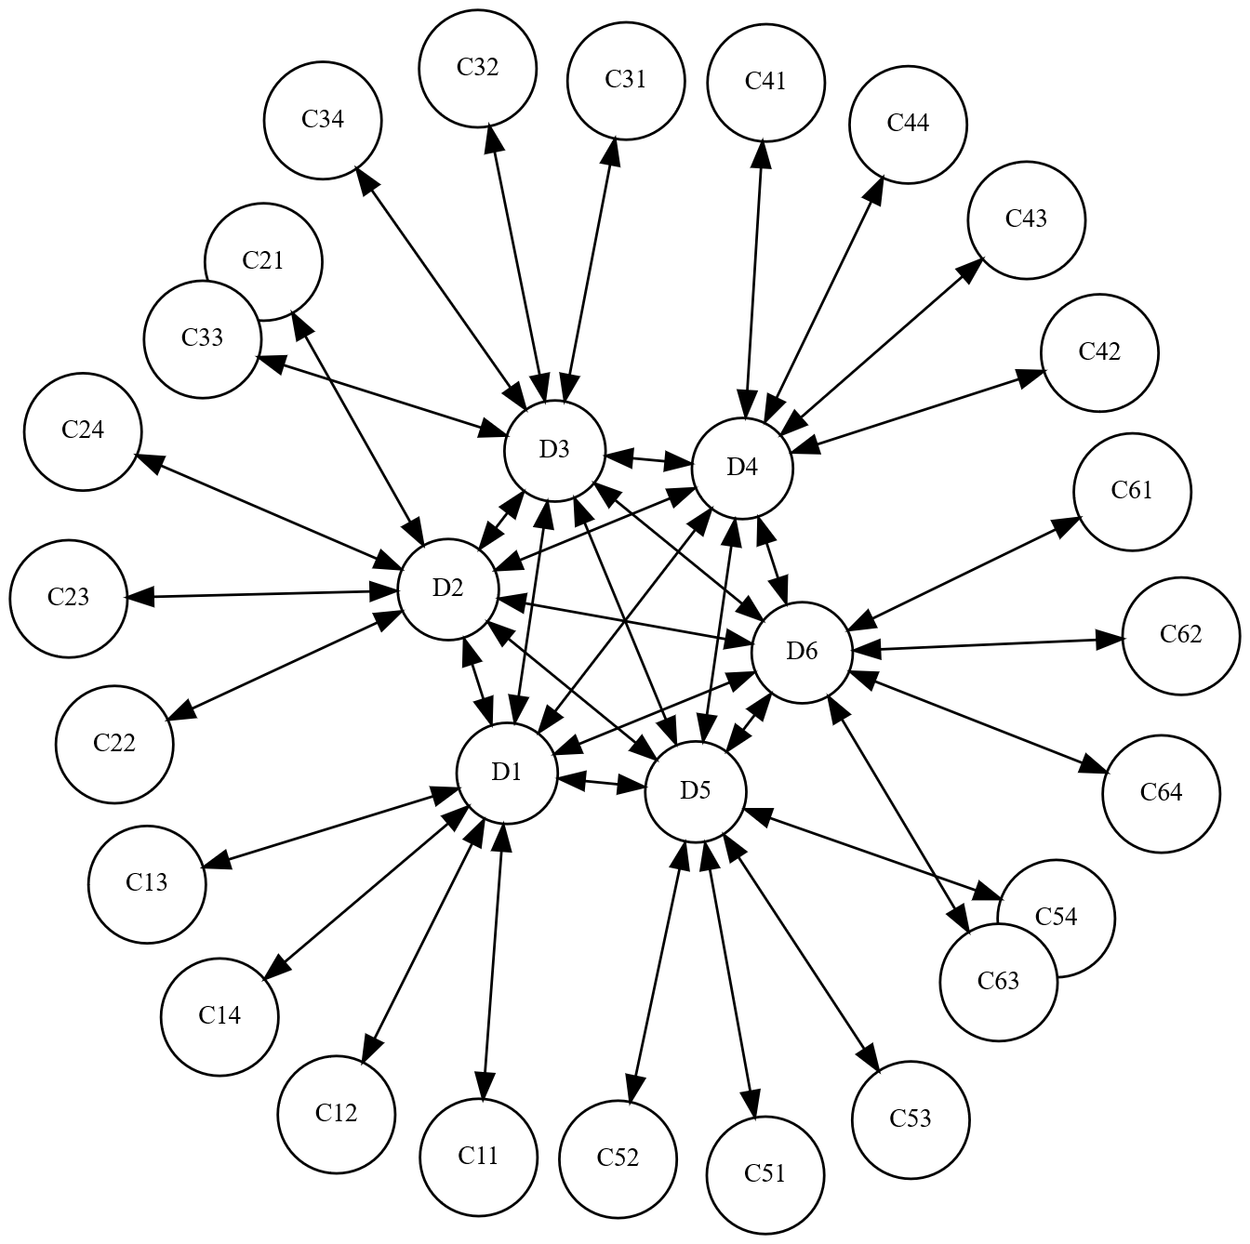
Harmonized Web API for real-time data
A unified Smart City API
Notes:
```neato
digraph G
{
ratio=fill
size="7,7!"
bgcolor="transparent"
node [fontsize=10,width=.05,height=.05,shape=circle,style=filled,fillcolor=white]
D1 -> D2 [dir=both]
D1 -> D3 [dir=both]
D1 -> D4 [dir=both]
D1 -> D5 [dir=both]
D1 -> D6 [dir=both]
D2 -> D3 [dir=both]
D2 -> D4 [dir=both]
D2 -> D5 [dir=both]
D2 -> D6 [dir=both]
D3 -> D4 [dir=both]
D3 -> D5 [dir=both]
D3 -> D6 [dir=both]
D4 -> D5 [dir=both]
D4 -> D6 [dir=both]
D5 -> D6 [dir=both]
C11 -> D1 [dir=both]
C12 -> D1 [dir=both]
C13 -> D1 [dir=both]
C14 -> D1 [dir=both]
C21 -> D2 [dir=both]
C22 -> D2 [dir=both]
C23 -> D2 [dir=both]
C24 -> D2 [dir=both]
C31 -> D3 [dir=both]
C32 -> D3 [dir=both]
C33 -> D3 [dir=both]
C34 -> D3 [dir=both]
C41 -> D4 [dir=both]
C42 -> D4 [dir=both]
C43 -> D4 [dir=both]
C44 -> D4 [dir=both]
C51 -> D5 [dir=both]
C52 -> D5 [dir=both]
C53 -> D5 [dir=both]
C54 -> D5 [dir=both]
C61 -> D6 [dir=both]
C62 -> D6 [dir=both]
C63 -> D6 [dir=both]
C64 -> D6 [dir=both]
}
```

Slide 2
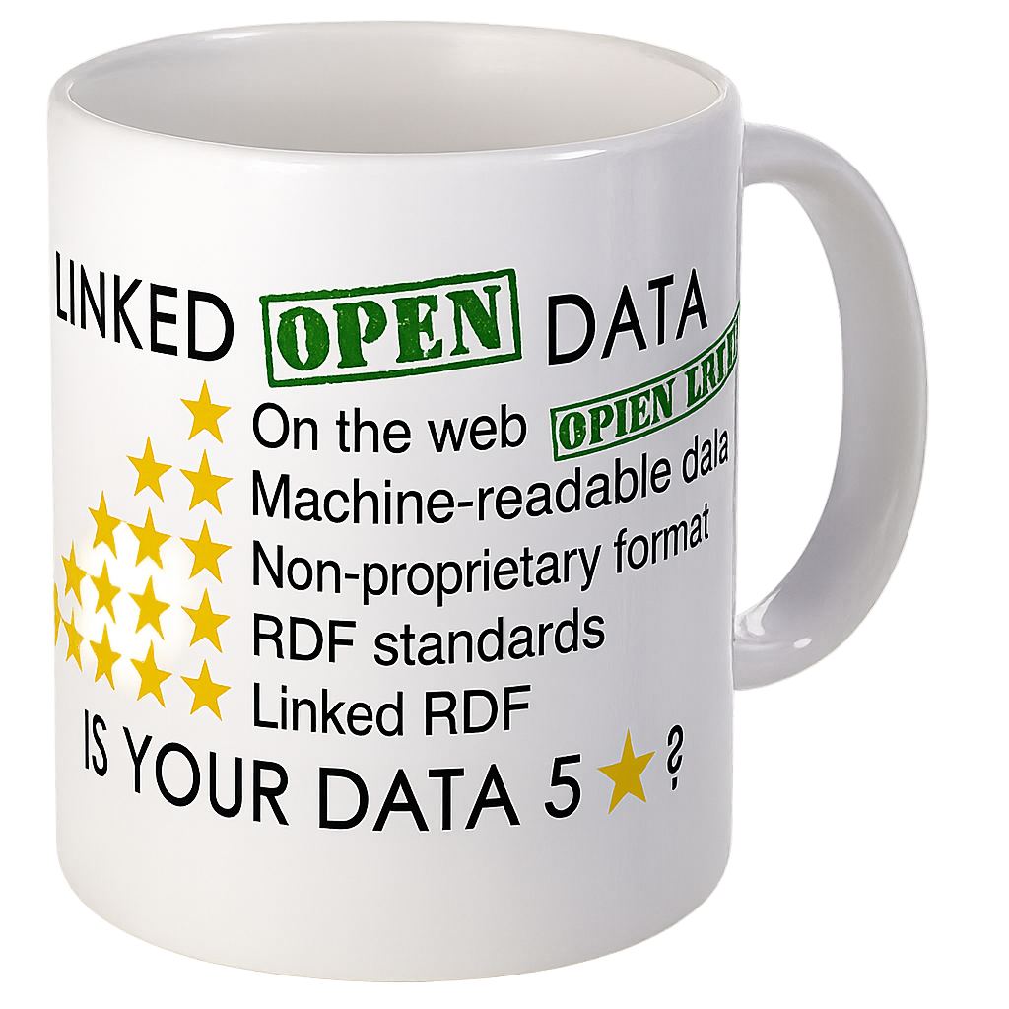
Unified Information Model
Semantic Triples (S, P, O)
Subject (S) and Predicate (P) are always URIs
Object (S) can be URIs or LITERALs.
LITERALs can be typed.
Types are URIs
Can describe all information humans can express in writing
Can describe any object or class in OOP
Inheritance (even for predicates)
Linked
Federated
Distributed
Open World Assumption
https://www.w3.org/2013/data/
https://www.w3.org/2013/data/
Notes:
```dot: Incentivising the development of the Smart City
digraph G {
bgcolor="transparent"
node [fillcolor=white,style="filled,solid"]
"cybercity.online" -> "Neuro-Foundation IoT Harmonization"
"Neuro-Foundation IoT Harmonization" [URL="#neuroFoundationIotHarmonization"]
"Neuro-Foundation IoT Harmonization" -> "Open Standards"
"Neuro-Foundation IoT Harmonization" -> "Federation"
"Neuro-Foundation IoT Harmonization" -> "Protocol Bridging"
"Open Standards" [URL="#openStandards"]
"Open Standards" -> "Interoperability"
"Protocol Bridging" [URL="#protocolBridging"]
"Protocol Bridging" -> "Interoperability"
"Federation" [URL="#federation"]
"Federation" -> "Global Identities"
"Federation" -> "Topology Independence"
"Federation" -> "Global Scalability"
"Federation" -> "Ubiquitous Encryption"
"Topology Independence" [URL="#topologyIndependence"]
"Topology Independence" -> "Resilience"
"Global Scalability" [URL="#globalScalability"]
"Global Scalability" -> "Resilience"
"Global Identities" -> "Secure Registration"
"Global Identities" -> "Authentication"
"Authentication" [URL="#authentication"]
"Authentication" -> "Consent"
"Consent" [URL="#consent"]
"Consent" -> "Authorization"
"Global Identities" [URL="#globalIdentities"]
"Global Identities" -> "Discovery"
"Discovery" [URL="#discovery"]
"Discovery" -> "Ownership"
"Ownership" [URL="#ownership"]
"Ownership" -> "Decision Support"
"Authorization" [URL="#authorization"]
"Authorization" -> "Decision Support"
"Resilience" [URL="#resilience"]
"Resilience" -> "Security"
"Secure Registration" [URL="#secureRegistration"]
"Secure Registration" -> "Security"
"Authentication" -> "Security"
"Authorization" -> "Security"
"Ubiquitous Encryption" [URL="#ubiquitousEncryption"]
"Ubiquitous Encryption" -> "Security"
"Decision Support" [URL="#decisionSupport"]
"Decision Support" -> "Security"
"Decision Support" -> "Edge Computing"
"Edge Computing" [URL="#edgeComputing"]
"Edge Computing" -> "Privacy"
"Interoperability" [URL="#interoperability"]
"Interoperability" -> "Contracts"
"Decision Support" -> "Contracts"
"Privacy" [URL="#privacy"]
"Privacy" -> "Marketplace of Things and Data"
"Security" [URL="#security"]
"Security" -> "Marketplace of Things and Data"
"Contracts" [URL="#contracts"]
"Contracts" -> "Marketplace of Things and Data"
"Marketplace of Things and Data" [URL="#marketplaceOfThingsAndData"]
"Marketplace of Things and Data" -> "Economic Feedback"
"Economic Feedback" [URL="#economicFeedback"]
"Economic Feedback" -> "Incentives to develop the Smart City"
"Incentives to develop the Smart City" [URL="#incentivesToDevelopTheSmartCity"]
}
```

Slide 3
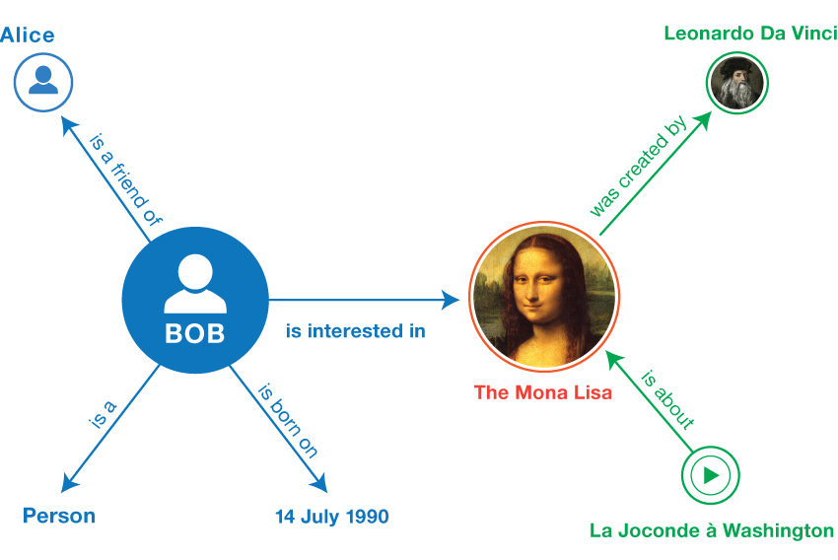

Representation
N3 – Plain Text
Turtle – Plain Text
Resource Description Framework (RDF) - XML
JSON-LD – JSON
https://www.w3.org/TR/rdf12-primer/
https://www.w3.org/TR/rdf12-turtle/
https://json-ld.org/
https://www.w3.org/2013/data/
Notes:
```dot: Incentivising the development of the Smart City
digraph G {
bgcolor="transparent"
node [fillcolor=white,style="filled,solid"]
"cybercity.online" -> "Neuro-Foundation IoT Harmonization"
"Neuro-Foundation IoT Harmonization" [URL="#neuroFoundationIotHarmonization"]
"Neuro-Foundation IoT Harmonization" -> "Open Standards"
"Neuro-Foundation IoT Harmonization" -> "Federation"
"Neuro-Foundation IoT Harmonization" -> "Protocol Bridging"
"Open Standards" [URL="#openStandards"]
"Open Standards" -> "Interoperability"
"Protocol Bridging" [URL="#protocolBridging"]
"Protocol Bridging" -> "Interoperability"
"Federation" [URL="#federation"]
"Federation" -> "Global Identities"
"Federation" -> "Topology Independence"
"Federation" -> "Global Scalability"
"Federation" -> "Ubiquitous Encryption"
"Topology Independence" [URL="#topologyIndependence"]
"Topology Independence" -> "Resilience"
"Global Scalability" [URL="#globalScalability"]
"Global Scalability" -> "Resilience"
"Global Identities" -> "Secure Registration"
"Global Identities" -> "Authentication"
"Authentication" [URL="#authentication"]
"Authentication" -> "Consent"
"Consent" [URL="#consent"]
"Consent" -> "Authorization"
"Global Identities" [URL="#globalIdentities"]
"Global Identities" -> "Discovery"
"Discovery" [URL="#discovery"]
"Discovery" -> "Ownership"
"Ownership" [URL="#ownership"]
"Ownership" -> "Decision Support"
"Authorization" [URL="#authorization"]
"Authorization" -> "Decision Support"
"Resilience" [URL="#resilience"]
"Resilience" -> "Security"
"Secure Registration" [URL="#secureRegistration"]
"Secure Registration" -> "Security"
"Authentication" -> "Security"
"Authorization" -> "Security"
"Ubiquitous Encryption" [URL="#ubiquitousEncryption"]
"Ubiquitous Encryption" -> "Security"
"Decision Support" [URL="#decisionSupport"]
"Decision Support" -> "Security"
"Decision Support" -> "Edge Computing"
"Edge Computing" [URL="#edgeComputing"]
"Edge Computing" -> "Privacy"
"Interoperability" [URL="#interoperability"]
"Interoperability" -> "Contracts"
"Decision Support" -> "Contracts"
"Privacy" [URL="#privacy"]
"Privacy" -> "Marketplace of Things and Data"
"Security" [URL="#security"]
"Security" -> "Marketplace of Things and Data"
"Contracts" [URL="#contracts"]
"Contracts" -> "Marketplace of Things and Data"
"Marketplace of Things and Data" [URL="#marketplaceOfThingsAndData"]
"Marketplace of Things and Data" -> "Economic Feedback"
"Economic Feedback" [URL="#economicFeedback"]
"Economic Feedback" -> "Incentives to develop the Smart City"
"Incentives to develop the Smart City" [URL="#incentivesToDevelopTheSmartCity"]
}
```

Slide 4
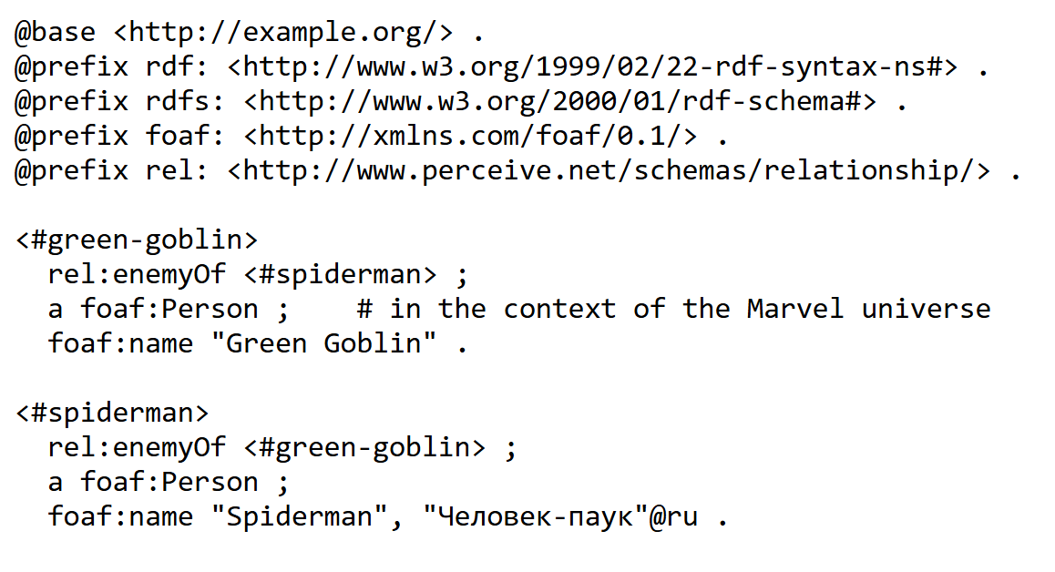
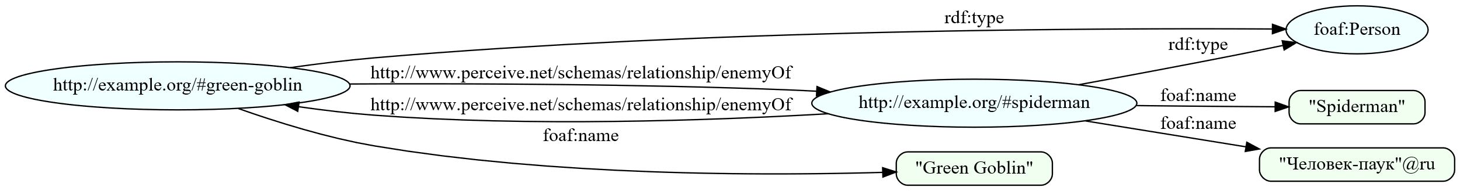
Example - Turtle
https://lab.tagroot.io/Demo/TurtleExample.ttl
https://www.w3.org/2013/data/
Notes:
```dot: Incentivising the development of the Smart City
digraph G {
bgcolor="transparent"
node [fillcolor=white,style="filled,solid"]
"cybercity.online" -> "Neuro-Foundation IoT Harmonization"
"Neuro-Foundation IoT Harmonization" [URL="#neuroFoundationIotHarmonization"]
"Neuro-Foundation IoT Harmonization" -> "Open Standards"
"Neuro-Foundation IoT Harmonization" -> "Federation"
"Neuro-Foundation IoT Harmonization" -> "Protocol Bridging"
"Open Standards" [URL="#openStandards"]
"Open Standards" -> "Interoperability"
"Protocol Bridging" [URL="#protocolBridging"]
"Protocol Bridging" -> "Interoperability"
"Federation" [URL="#federation"]
"Federation" -> "Global Identities"
"Federation" -> "Topology Independence"
"Federation" -> "Global Scalability"
"Federation" -> "Ubiquitous Encryption"
"Topology Independence" [URL="#topologyIndependence"]
"Topology Independence" -> "Resilience"
"Global Scalability" [URL="#globalScalability"]
"Global Scalability" -> "Resilience"
"Global Identities" -> "Secure Registration"
"Global Identities" -> "Authentication"
"Authentication" [URL="#authentication"]
"Authentication" -> "Consent"
"Consent" [URL="#consent"]
"Consent" -> "Authorization"
"Global Identities" [URL="#globalIdentities"]
"Global Identities" -> "Discovery"
"Discovery" [URL="#discovery"]
"Discovery" -> "Ownership"
"Ownership" [URL="#ownership"]
"Ownership" -> "Decision Support"
"Authorization" [URL="#authorization"]
"Authorization" -> "Decision Support"
"Resilience" [URL="#resilience"]
"Resilience" -> "Security"
"Secure Registration" [URL="#secureRegistration"]
"Secure Registration" -> "Security"
"Authentication" -> "Security"
"Authorization" -> "Security"
"Ubiquitous Encryption" [URL="#ubiquitousEncryption"]
"Ubiquitous Encryption" -> "Security"
"Decision Support" [URL="#decisionSupport"]
"Decision Support" -> "Security"
"Decision Support" -> "Edge Computing"
"Edge Computing" [URL="#edgeComputing"]
"Edge Computing" -> "Privacy"
"Interoperability" [URL="#interoperability"]
"Interoperability" -> "Contracts"
"Decision Support" -> "Contracts"
"Privacy" [URL="#privacy"]
"Privacy" -> "Marketplace of Things and Data"
"Security" [URL="#security"]
"Security" -> "Marketplace of Things and Data"
"Contracts" [URL="#contracts"]
"Contracts" -> "Marketplace of Things and Data"
"Marketplace of Things and Data" [URL="#marketplaceOfThingsAndData"]
"Marketplace of Things and Data" -> "Economic Feedback"
"Economic Feedback" [URL="#economicFeedback"]
"Economic Feedback" -> "Incentives to develop the Smart City"
"Incentives to develop the Smart City" [URL="#incentivesToDevelopTheSmartCity"]
}
```

Slide 5
Meaning & Reasoning
Ontologies
RDF
RDF Schema (RDFS)
Web Ontology Language (OWL)
Dublin Core (DC)
Friend-of-a-Friend (FOAF)
Simple Knowledge Organization (SKOS)
…
https://lov.linkeddata.es/dataset/lov/
https://www.dublincore.org/
https://www.w3.org/2013/data/
Notes:
```dot: Incentivising the development of the Smart City
digraph G {
bgcolor="transparent"
node [fillcolor=white,style="filled,solid"]
"cybercity.online" -> "Neuro-Foundation IoT Harmonization"
"Neuro-Foundation IoT Harmonization" [URL="#neuroFoundationIotHarmonization"]
"Neuro-Foundation IoT Harmonization" -> "Open Standards"
"Neuro-Foundation IoT Harmonization" -> "Federation"
"Neuro-Foundation IoT Harmonization" -> "Protocol Bridging"
"Open Standards" [URL="#openStandards"]
"Open Standards" -> "Interoperability"
"Protocol Bridging" [URL="#protocolBridging"]
"Protocol Bridging" -> "Interoperability"
"Federation" [URL="#federation"]
"Federation" -> "Global Identities"
"Federation" -> "Topology Independence"
"Federation" -> "Global Scalability"
"Federation" -> "Ubiquitous Encryption"
"Topology Independence" [URL="#topologyIndependence"]
"Topology Independence" -> "Resilience"
"Global Scalability" [URL="#globalScalability"]
"Global Scalability" -> "Resilience"
"Global Identities" -> "Secure Registration"
"Global Identities" -> "Authentication"
"Authentication" [URL="#authentication"]
"Authentication" -> "Consent"
"Consent" [URL="#consent"]
"Consent" -> "Authorization"
"Global Identities" [URL="#globalIdentities"]
"Global Identities" -> "Discovery"
"Discovery" [URL="#discovery"]
"Discovery" -> "Ownership"
"Ownership" [URL="#ownership"]
"Ownership" -> "Decision Support"
"Authorization" [URL="#authorization"]
"Authorization" -> "Decision Support"
"Resilience" [URL="#resilience"]
"Resilience" -> "Security"
"Secure Registration" [URL="#secureRegistration"]
"Secure Registration" -> "Security"
"Authentication" -> "Security"
"Authorization" -> "Security"
"Ubiquitous Encryption" [URL="#ubiquitousEncryption"]
"Ubiquitous Encryption" -> "Security"
"Decision Support" [URL="#decisionSupport"]
"Decision Support" -> "Security"
"Decision Support" -> "Edge Computing"
"Edge Computing" [URL="#edgeComputing"]
"Edge Computing" -> "Privacy"
"Interoperability" [URL="#interoperability"]
"Interoperability" -> "Contracts"
"Decision Support" -> "Contracts"
"Privacy" [URL="#privacy"]
"Privacy" -> "Marketplace of Things and Data"
"Security" [URL="#security"]
"Security" -> "Marketplace of Things and Data"
"Contracts" [URL="#contracts"]
"Contracts" -> "Marketplace of Things and Data"
"Marketplace of Things and Data" [URL="#marketplaceOfThingsAndData"]
"Marketplace of Things and Data" -> "Economic Feedback"
"Economic Feedback" [URL="#economicFeedback"]
"Economic Feedback" -> "Incentives to develop the Smart City"
"Incentives to develop the Smart City" [URL="#incentivesToDevelopTheSmartCity"]
}
```

Slide 6

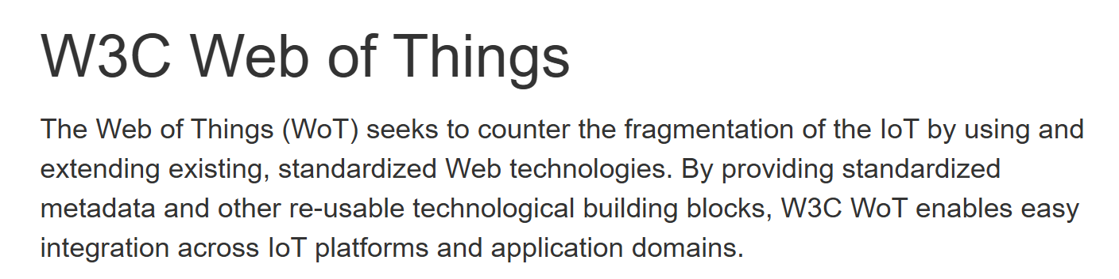
Persisted Storage
Downloadable Online Resources
Graph Databases
Graph Store
Query Endpoints (SPARQL)
Proposed
Dynamic Generation of transient information
Bridge real-time IoT, as per W3C Vision
Create a Unified API for the Smart Society using SPARQL
https://www.w3.org/WoT/
https://www.w3.org/TR/sparql12-protocol/
https://www.w3.org/TR/sparql12-graph-store-protocol/
https://www.w3.org/2013/data/
Notes:
```dot: Incentivising the development of the Smart City
digraph G {
bgcolor="transparent"
node [fillcolor=white,style="filled,solid"]
"cybercity.online" -> "Neuro-Foundation IoT Harmonization"
"Neuro-Foundation IoT Harmonization" [URL="#neuroFoundationIotHarmonization"]
"Neuro-Foundation IoT Harmonization" -> "Open Standards"
"Neuro-Foundation IoT Harmonization" -> "Federation"
"Neuro-Foundation IoT Harmonization" -> "Protocol Bridging"
"Open Standards" [URL="#openStandards"]
"Open Standards" -> "Interoperability"
"Protocol Bridging" [URL="#protocolBridging"]
"Protocol Bridging" -> "Interoperability"
"Federation" [URL="#federation"]
"Federation" -> "Global Identities"
"Federation" -> "Topology Independence"
"Federation" -> "Global Scalability"
"Federation" -> "Ubiquitous Encryption"
"Topology Independence" [URL="#topologyIndependence"]
"Topology Independence" -> "Resilience"
"Global Scalability" [URL="#globalScalability"]
"Global Scalability" -> "Resilience"
"Global Identities" -> "Secure Registration"
"Global Identities" -> "Authentication"
"Authentication" [URL="#authentication"]
"Authentication" -> "Consent"
"Consent" [URL="#consent"]
"Consent" -> "Authorization"
"Global Identities" [URL="#globalIdentities"]
"Global Identities" -> "Discovery"
"Discovery" [URL="#discovery"]
"Discovery" -> "Ownership"
"Ownership" [URL="#ownership"]
"Ownership" -> "Decision Support"
"Authorization" [URL="#authorization"]
"Authorization" -> "Decision Support"
"Resilience" [URL="#resilience"]
"Resilience" -> "Security"
"Secure Registration" [URL="#secureRegistration"]
"Secure Registration" -> "Security"
"Authentication" -> "Security"
"Authorization" -> "Security"
"Ubiquitous Encryption" [URL="#ubiquitousEncryption"]
"Ubiquitous Encryption" -> "Security"
"Decision Support" [URL="#decisionSupport"]
"Decision Support" -> "Security"
"Decision Support" -> "Edge Computing"
"Edge Computing" [URL="#edgeComputing"]
"Edge Computing" -> "Privacy"
"Interoperability" [URL="#interoperability"]
"Interoperability" -> "Contracts"
"Decision Support" -> "Contracts"
"Privacy" [URL="#privacy"]
"Privacy" -> "Marketplace of Things and Data"
"Security" [URL="#security"]
"Security" -> "Marketplace of Things and Data"
"Contracts" [URL="#contracts"]
"Contracts" -> "Marketplace of Things and Data"
"Marketplace of Things and Data" [URL="#marketplaceOfThingsAndData"]
"Marketplace of Things and Data" -> "Economic Feedback"
"Economic Feedback" [URL="#economicFeedback"]
"Economic Feedback" -> "Incentives to develop the Smart City"
"Incentives to develop the Smart City" [URL="#incentivesToDevelopTheSmartCity"]
}
```

Slide 7
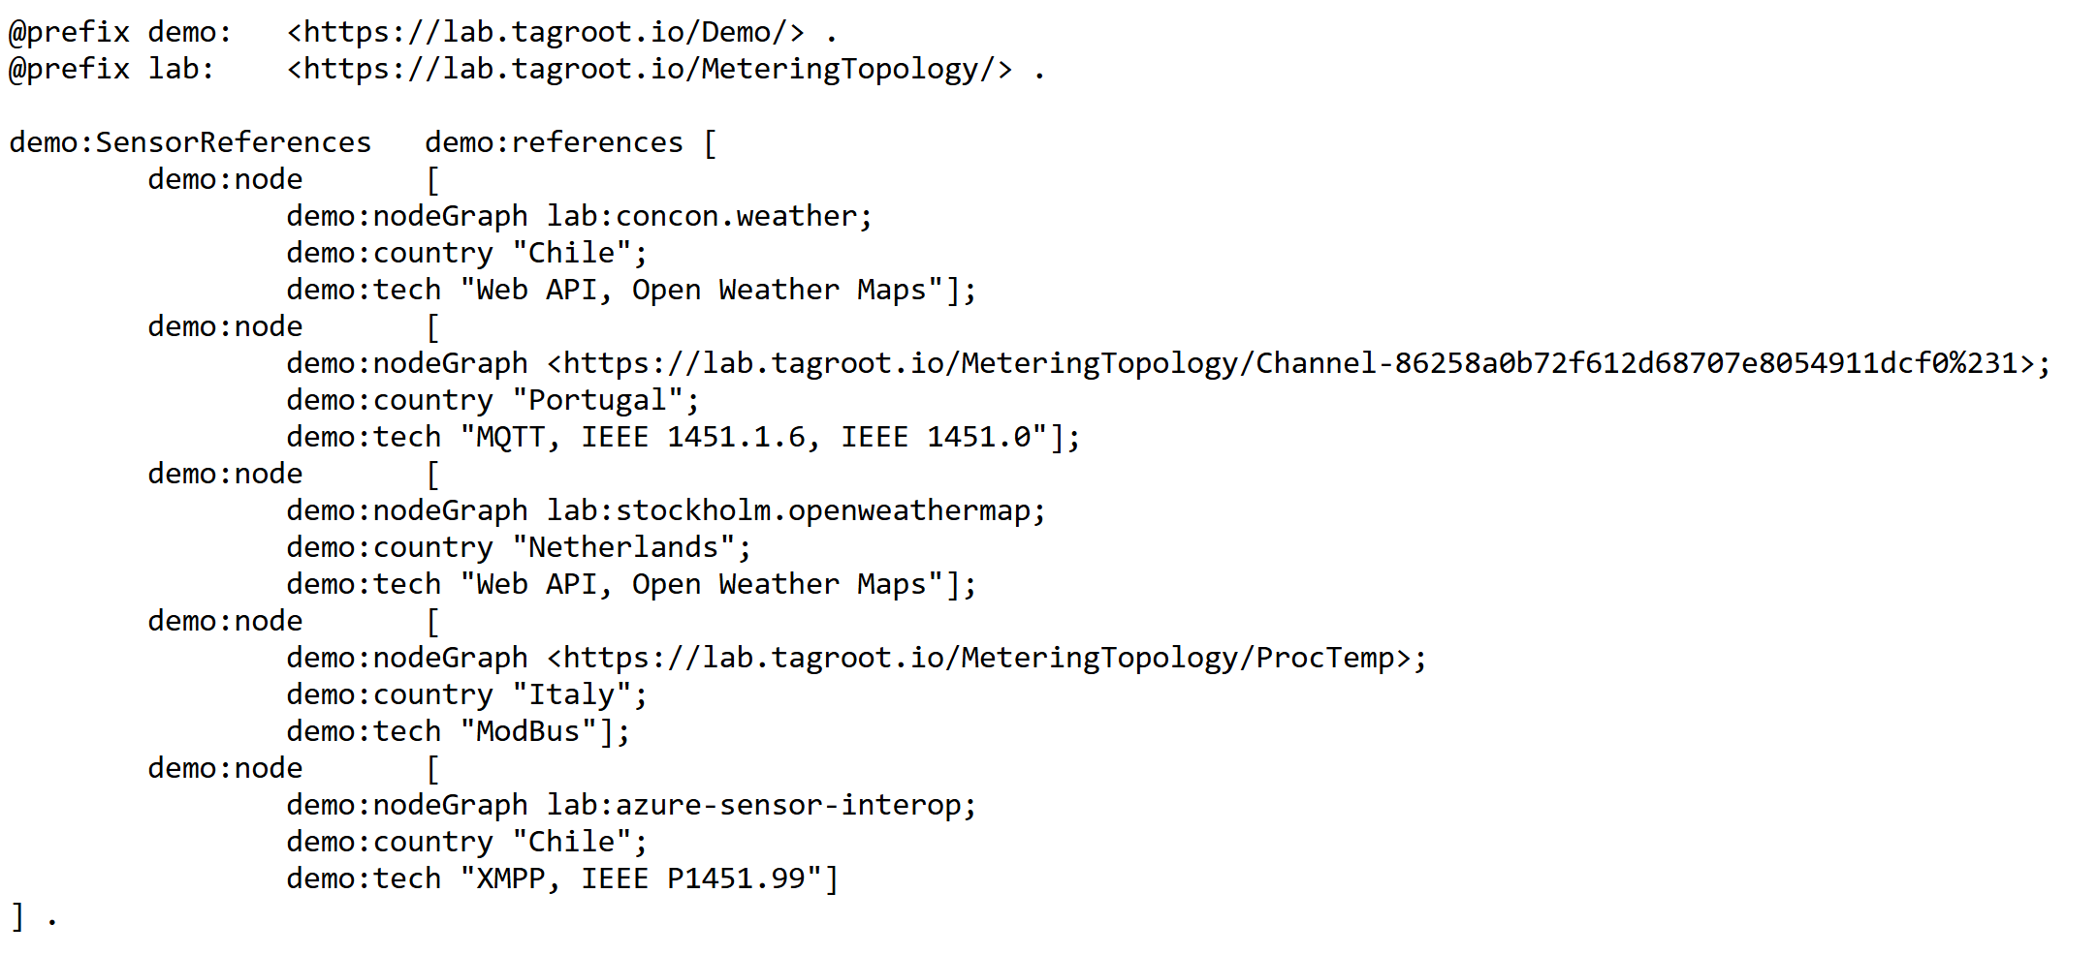
SPARQL Examples – Sensor References (1)
https://lab.tagroot.io/Demo/SparqlExamples.txt
https://lab.tagroot.io/Demo/SensorReferences.ttl
https://lab.tagroot.io/Sparql.md
https://www.w3.org/2013/data/
Notes:
```dot: Incentivising the development of the Smart City
digraph G {
bgcolor="transparent"
node [fillcolor=white,style="filled,solid"]
"cybercity.online" -> "Neuro-Foundation IoT Harmonization"
"Neuro-Foundation IoT Harmonization" [URL="#neuroFoundationIotHarmonization"]
"Neuro-Foundation IoT Harmonization" -> "Open Standards"
"Neuro-Foundation IoT Harmonization" -> "Federation"
"Neuro-Foundation IoT Harmonization" -> "Protocol Bridging"
"Open Standards" [URL="#openStandards"]
"Open Standards" -> "Interoperability"
"Protocol Bridging" [URL="#protocolBridging"]
"Protocol Bridging" -> "Interoperability"
"Federation" [URL="#federation"]
"Federation" -> "Global Identities"
"Federation" -> "Topology Independence"
"Federation" -> "Global Scalability"
"Federation" -> "Ubiquitous Encryption"
"Topology Independence" [URL="#topologyIndependence"]
"Topology Independence" -> "Resilience"
"Global Scalability" [URL="#globalScalability"]
"Global Scalability" -> "Resilience"
"Global Identities" -> "Secure Registration"
"Global Identities" -> "Authentication"
"Authentication" [URL="#authentication"]
"Authentication" -> "Consent"
"Consent" [URL="#consent"]
"Consent" -> "Authorization"
"Global Identities" [URL="#globalIdentities"]
"Global Identities" -> "Discovery"
"Discovery" [URL="#discovery"]
"Discovery" -> "Ownership"
"Ownership" [URL="#ownership"]
"Ownership" -> "Decision Support"
"Authorization" [URL="#authorization"]
"Authorization" -> "Decision Support"
"Resilience" [URL="#resilience"]
"Resilience" -> "Security"
"Secure Registration" [URL="#secureRegistration"]
"Secure Registration" -> "Security"
"Authentication" -> "Security"
"Authorization" -> "Security"
"Ubiquitous Encryption" [URL="#ubiquitousEncryption"]
"Ubiquitous Encryption" -> "Security"
"Decision Support" [URL="#decisionSupport"]
"Decision Support" -> "Security"
"Decision Support" -> "Edge Computing"
"Edge Computing" [URL="#edgeComputing"]
"Edge Computing" -> "Privacy"
"Interoperability" [URL="#interoperability"]
"Interoperability" -> "Contracts"
"Decision Support" -> "Contracts"
"Privacy" [URL="#privacy"]
"Privacy" -> "Marketplace of Things and Data"
"Security" [URL="#security"]
"Security" -> "Marketplace of Things and Data"
"Contracts" [URL="#contracts"]
"Contracts" -> "Marketplace of Things and Data"
"Marketplace of Things and Data" [URL="#marketplaceOfThingsAndData"]
"Marketplace of Things and Data" -> "Economic Feedback"
"Economic Feedback" [URL="#economicFeedback"]
"Economic Feedback" -> "Incentives to develop the Smart City"
"Incentives to develop the Smart City" [URL="#incentivesToDevelopTheSmartCity"]
}
```

Slide 8
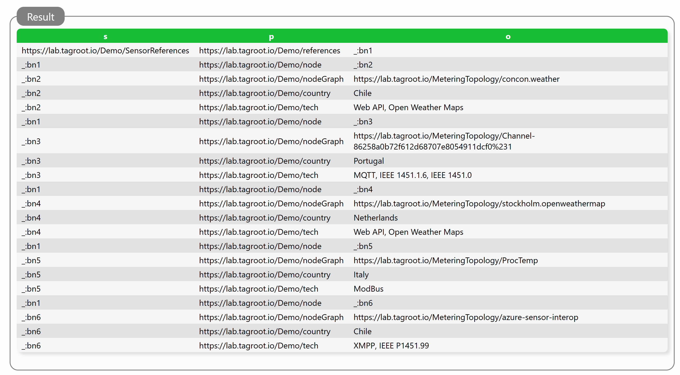
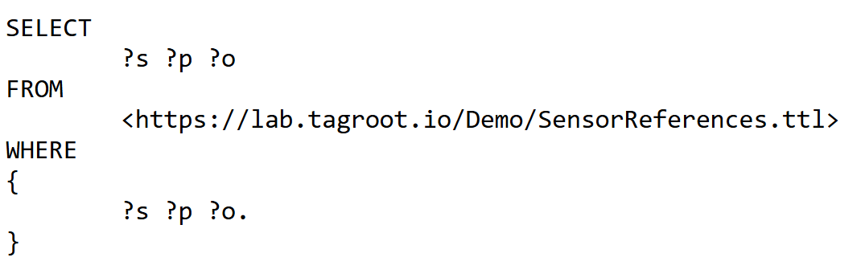
SPARQL Examples – Sensor References (2)
https://lab.tagroot.io/Demo/SparqlExamples.txt
https://lab.tagroot.io/Demo/SensorReferences.ttl
https://lab.tagroot.io/Sparql.md
https://www.w3.org/2013/data/
Notes:
```dot: Incentivising the development of the Smart City
digraph G {
bgcolor="transparent"
node [fillcolor=white,style="filled,solid"]
"cybercity.online" -> "Neuro-Foundation IoT Harmonization"
"Neuro-Foundation IoT Harmonization" [URL="#neuroFoundationIotHarmonization"]
"Neuro-Foundation IoT Harmonization" -> "Open Standards"
"Neuro-Foundation IoT Harmonization" -> "Federation"
"Neuro-Foundation IoT Harmonization" -> "Protocol Bridging"
"Open Standards" [URL="#openStandards"]
"Open Standards" -> "Interoperability"
"Protocol Bridging" [URL="#protocolBridging"]
"Protocol Bridging" -> "Interoperability"
"Federation" [URL="#federation"]
"Federation" -> "Global Identities"
"Federation" -> "Topology Independence"
"Federation" -> "Global Scalability"
"Federation" -> "Ubiquitous Encryption"
"Topology Independence" [URL="#topologyIndependence"]
"Topology Independence" -> "Resilience"
"Global Scalability" [URL="#globalScalability"]
"Global Scalability" -> "Resilience"
"Global Identities" -> "Secure Registration"
"Global Identities" -> "Authentication"
"Authentication" [URL="#authentication"]
"Authentication" -> "Consent"
"Consent" [URL="#consent"]
"Consent" -> "Authorization"
"Global Identities" [URL="#globalIdentities"]
"Global Identities" -> "Discovery"
"Discovery" [URL="#discovery"]
"Discovery" -> "Ownership"
"Ownership" [URL="#ownership"]
"Ownership" -> "Decision Support"
"Authorization" [URL="#authorization"]
"Authorization" -> "Decision Support"
"Resilience" [URL="#resilience"]
"Resilience" -> "Security"
"Secure Registration" [URL="#secureRegistration"]
"Secure Registration" -> "Security"
"Authentication" -> "Security"
"Authorization" -> "Security"
"Ubiquitous Encryption" [URL="#ubiquitousEncryption"]
"Ubiquitous Encryption" -> "Security"
"Decision Support" [URL="#decisionSupport"]
"Decision Support" -> "Security"
"Decision Support" -> "Edge Computing"
"Edge Computing" [URL="#edgeComputing"]
"Edge Computing" -> "Privacy"
"Interoperability" [URL="#interoperability"]
"Interoperability" -> "Contracts"
"Decision Support" -> "Contracts"
"Privacy" [URL="#privacy"]
"Privacy" -> "Marketplace of Things and Data"
"Security" [URL="#security"]
"Security" -> "Marketplace of Things and Data"
"Contracts" [URL="#contracts"]
"Contracts" -> "Marketplace of Things and Data"
"Marketplace of Things and Data" [URL="#marketplaceOfThingsAndData"]
"Marketplace of Things and Data" -> "Economic Feedback"
"Economic Feedback" [URL="#economicFeedback"]
"Economic Feedback" -> "Incentives to develop the Smart City"
"Incentives to develop the Smart City" [URL="#incentivesToDevelopTheSmartCity"]
}
```

Slide 9
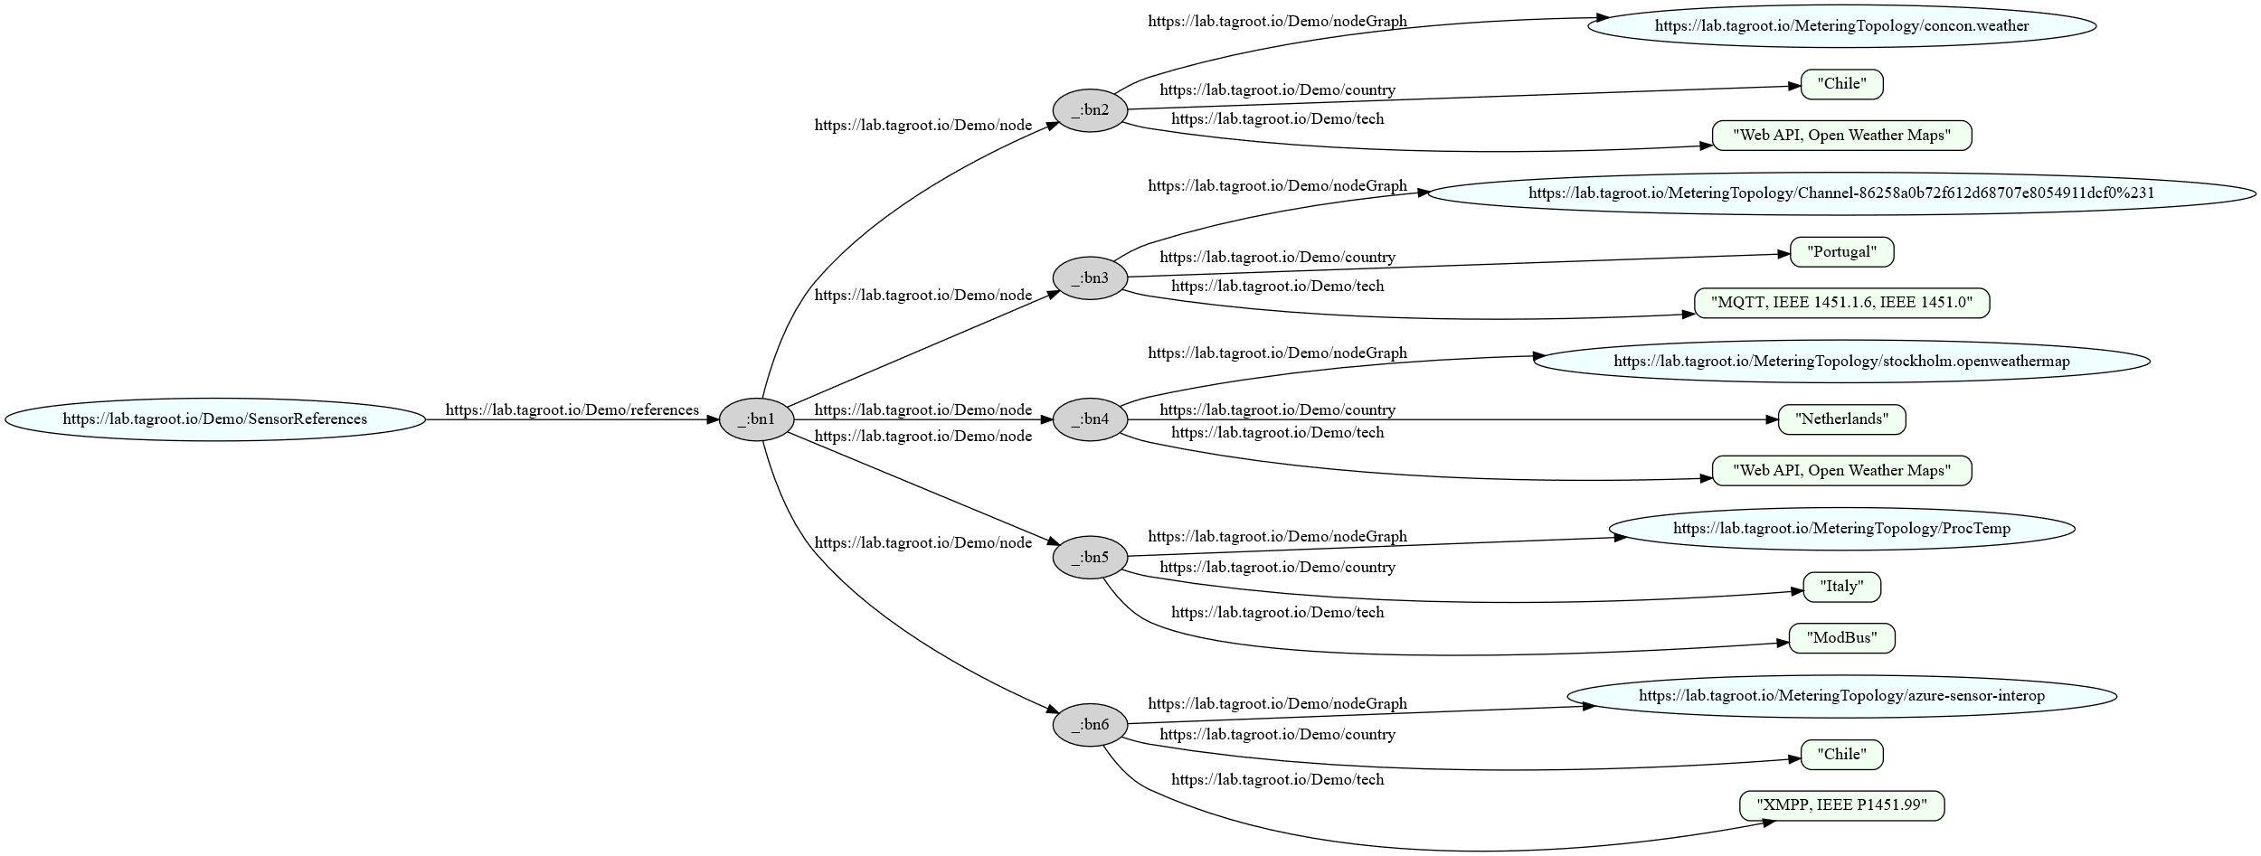
SPARQL Examples – Sensor References (3)
https://lab.tagroot.io/Demo/SparqlExamples.txt
https://lab.tagroot.io/Demo/SensorReferences.ttl
https://lab.tagroot.io/Sparql.md
https://www.w3.org/2013/data/
Notes:
```dot: Incentivising the development of the Smart City
digraph G {
bgcolor="transparent"
node [fillcolor=white,style="filled,solid"]
"cybercity.online" -> "Neuro-Foundation IoT Harmonization"
"Neuro-Foundation IoT Harmonization" [URL="#neuroFoundationIotHarmonization"]
"Neuro-Foundation IoT Harmonization" -> "Open Standards"
"Neuro-Foundation IoT Harmonization" -> "Federation"
"Neuro-Foundation IoT Harmonization" -> "Protocol Bridging"
"Open Standards" [URL="#openStandards"]
"Open Standards" -> "Interoperability"
"Protocol Bridging" [URL="#protocolBridging"]
"Protocol Bridging" -> "Interoperability"
"Federation" [URL="#federation"]
"Federation" -> "Global Identities"
"Federation" -> "Topology Independence"
"Federation" -> "Global Scalability"
"Federation" -> "Ubiquitous Encryption"
"Topology Independence" [URL="#topologyIndependence"]
"Topology Independence" -> "Resilience"
"Global Scalability" [URL="#globalScalability"]
"Global Scalability" -> "Resilience"
"Global Identities" -> "Secure Registration"
"Global Identities" -> "Authentication"
"Authentication" [URL="#authentication"]
"Authentication" -> "Consent"
"Consent" [URL="#consent"]
"Consent" -> "Authorization"
"Global Identities" [URL="#globalIdentities"]
"Global Identities" -> "Discovery"
"Discovery" [URL="#discovery"]
"Discovery" -> "Ownership"
"Ownership" [URL="#ownership"]
"Ownership" -> "Decision Support"
"Authorization" [URL="#authorization"]
"Authorization" -> "Decision Support"
"Resilience" [URL="#resilience"]
"Resilience" -> "Security"
"Secure Registration" [URL="#secureRegistration"]
"Secure Registration" -> "Security"
"Authentication" -> "Security"
"Authorization" -> "Security"
"Ubiquitous Encryption" [URL="#ubiquitousEncryption"]
"Ubiquitous Encryption" -> "Security"
"Decision Support" [URL="#decisionSupport"]
"Decision Support" -> "Security"
"Decision Support" -> "Edge Computing"
"Edge Computing" [URL="#edgeComputing"]
"Edge Computing" -> "Privacy"
"Interoperability" [URL="#interoperability"]
"Interoperability" -> "Contracts"
"Decision Support" -> "Contracts"
"Privacy" [URL="#privacy"]
"Privacy" -> "Marketplace of Things and Data"
"Security" [URL="#security"]
"Security" -> "Marketplace of Things and Data"
"Contracts" [URL="#contracts"]
"Contracts" -> "Marketplace of Things and Data"
"Marketplace of Things and Data" [URL="#marketplaceOfThingsAndData"]
"Marketplace of Things and Data" -> "Economic Feedback"
"Economic Feedback" [URL="#economicFeedback"]
"Economic Feedback" -> "Incentives to develop the Smart City"
"Incentives to develop the Smart City" [URL="#incentivesToDevelopTheSmartCity"]
}
```

Slide 10
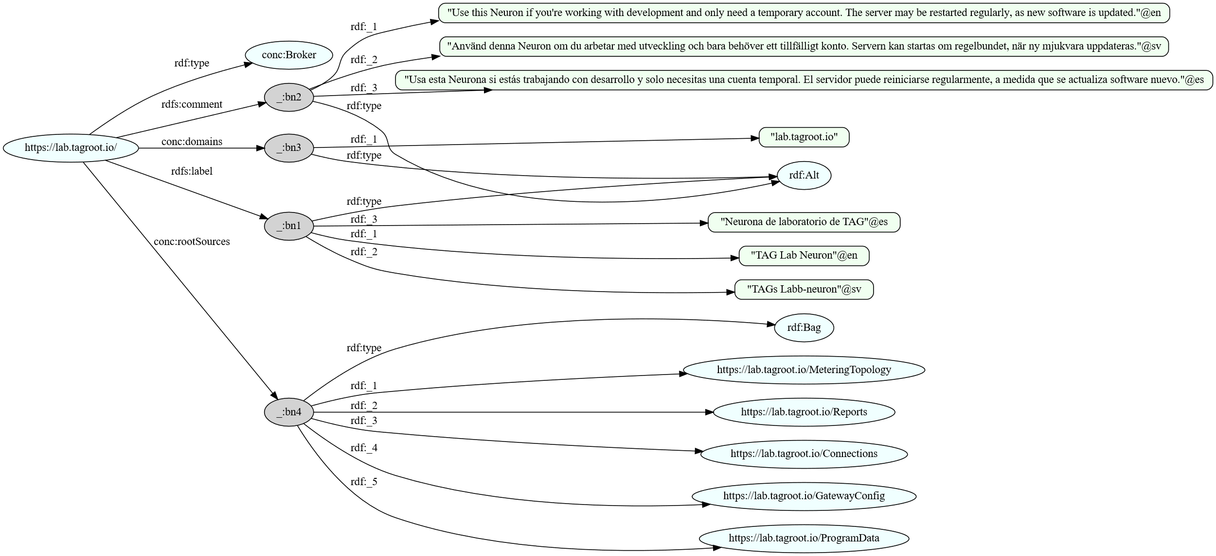
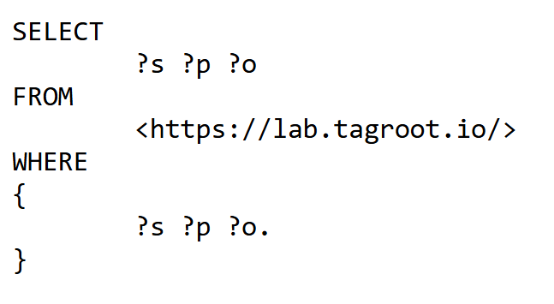
SPARQL Examples – Neuron Root
https://lab.tagroot.io/Demo/SparqlExamples.txt
https://lab.tagroot.io/Sparql.md
https://www.w3.org/2013/data/
Notes:
```dot: Incentivising the development of the Smart City
digraph G {
bgcolor="transparent"
node [fillcolor=white,style="filled,solid"]
"cybercity.online" -> "Neuro-Foundation IoT Harmonization"
"Neuro-Foundation IoT Harmonization" [URL="#neuroFoundationIotHarmonization"]
"Neuro-Foundation IoT Harmonization" -> "Open Standards"
"Neuro-Foundation IoT Harmonization" -> "Federation"
"Neuro-Foundation IoT Harmonization" -> "Protocol Bridging"
"Open Standards" [URL="#openStandards"]
"Open Standards" -> "Interoperability"
"Protocol Bridging" [URL="#protocolBridging"]
"Protocol Bridging" -> "Interoperability"
"Federation" [URL="#federation"]
"Federation" -> "Global Identities"
"Federation" -> "Topology Independence"
"Federation" -> "Global Scalability"
"Federation" -> "Ubiquitous Encryption"
"Topology Independence" [URL="#topologyIndependence"]
"Topology Independence" -> "Resilience"
"Global Scalability" [URL="#globalScalability"]
"Global Scalability" -> "Resilience"
"Global Identities" -> "Secure Registration"
"Global Identities" -> "Authentication"
"Authentication" [URL="#authentication"]
"Authentication" -> "Consent"
"Consent" [URL="#consent"]
"Consent" -> "Authorization"
"Global Identities" [URL="#globalIdentities"]
"Global Identities" -> "Discovery"
"Discovery" [URL="#discovery"]
"Discovery" -> "Ownership"
"Ownership" [URL="#ownership"]
"Ownership" -> "Decision Support"
"Authorization" [URL="#authorization"]
"Authorization" -> "Decision Support"
"Resilience" [URL="#resilience"]
"Resilience" -> "Security"
"Secure Registration" [URL="#secureRegistration"]
"Secure Registration" -> "Security"
"Authentication" -> "Security"
"Authorization" -> "Security"
"Ubiquitous Encryption" [URL="#ubiquitousEncryption"]
"Ubiquitous Encryption" -> "Security"
"Decision Support" [URL="#decisionSupport"]
"Decision Support" -> "Security"
"Decision Support" -> "Edge Computing"
"Edge Computing" [URL="#edgeComputing"]
"Edge Computing" -> "Privacy"
"Interoperability" [URL="#interoperability"]
"Interoperability" -> "Contracts"
"Decision Support" -> "Contracts"
"Privacy" [URL="#privacy"]
"Privacy" -> "Marketplace of Things and Data"
"Security" [URL="#security"]
"Security" -> "Marketplace of Things and Data"
"Contracts" [URL="#contracts"]
"Contracts" -> "Marketplace of Things and Data"
"Marketplace of Things and Data" [URL="#marketplaceOfThingsAndData"]
"Marketplace of Things and Data" -> "Economic Feedback"
"Economic Feedback" [URL="#economicFeedback"]
"Economic Feedback" -> "Incentives to develop the Smart City"
"Incentives to develop the Smart City" [URL="#incentivesToDevelopTheSmartCity"]
}
```

Slide 11
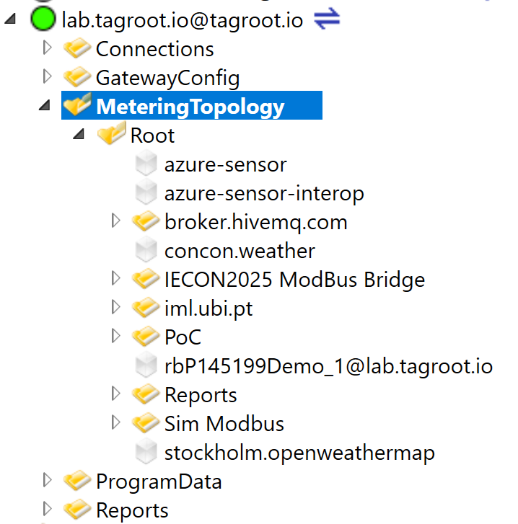
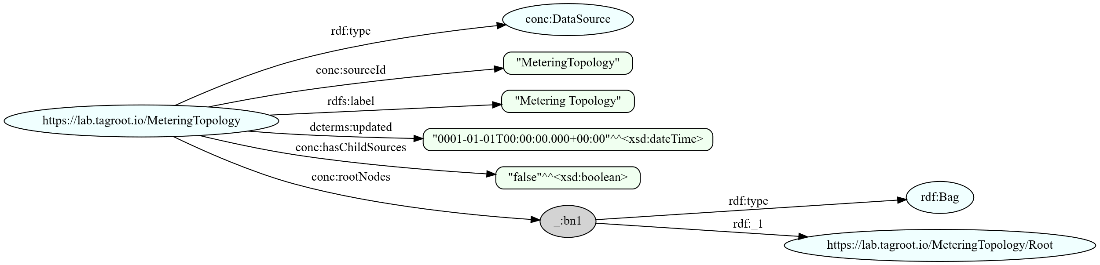
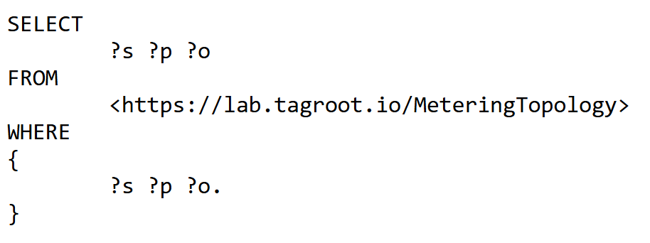
SPARQL Examples – Data Source
https://lab.tagroot.io/Demo/SparqlExamples.txt
https://lab.tagroot.io/Sparql.md
https://www.w3.org/2013/data/
Notes:
```dot: Incentivising the development of the Smart City
digraph G {
bgcolor="transparent"
node [fillcolor=white,style="filled,solid"]
"cybercity.online" -> "Neuro-Foundation IoT Harmonization"
"Neuro-Foundation IoT Harmonization" [URL="#neuroFoundationIotHarmonization"]
"Neuro-Foundation IoT Harmonization" -> "Open Standards"
"Neuro-Foundation IoT Harmonization" -> "Federation"
"Neuro-Foundation IoT Harmonization" -> "Protocol Bridging"
"Open Standards" [URL="#openStandards"]
"Open Standards" -> "Interoperability"
"Protocol Bridging" [URL="#protocolBridging"]
"Protocol Bridging" -> "Interoperability"
"Federation" [URL="#federation"]
"Federation" -> "Global Identities"
"Federation" -> "Topology Independence"
"Federation" -> "Global Scalability"
"Federation" -> "Ubiquitous Encryption"
"Topology Independence" [URL="#topologyIndependence"]
"Topology Independence" -> "Resilience"
"Global Scalability" [URL="#globalScalability"]
"Global Scalability" -> "Resilience"
"Global Identities" -> "Secure Registration"
"Global Identities" -> "Authentication"
"Authentication" [URL="#authentication"]
"Authentication" -> "Consent"
"Consent" [URL="#consent"]
"Consent" -> "Authorization"
"Global Identities" [URL="#globalIdentities"]
"Global Identities" -> "Discovery"
"Discovery" [URL="#discovery"]
"Discovery" -> "Ownership"
"Ownership" [URL="#ownership"]
"Ownership" -> "Decision Support"
"Authorization" [URL="#authorization"]
"Authorization" -> "Decision Support"
"Resilience" [URL="#resilience"]
"Resilience" -> "Security"
"Secure Registration" [URL="#secureRegistration"]
"Secure Registration" -> "Security"
"Authentication" -> "Security"
"Authorization" -> "Security"
"Ubiquitous Encryption" [URL="#ubiquitousEncryption"]
"Ubiquitous Encryption" -> "Security"
"Decision Support" [URL="#decisionSupport"]
"Decision Support" -> "Security"
"Decision Support" -> "Edge Computing"
"Edge Computing" [URL="#edgeComputing"]
"Edge Computing" -> "Privacy"
"Interoperability" [URL="#interoperability"]
"Interoperability" -> "Contracts"
"Decision Support" -> "Contracts"
"Privacy" [URL="#privacy"]
"Privacy" -> "Marketplace of Things and Data"
"Security" [URL="#security"]
"Security" -> "Marketplace of Things and Data"
"Contracts" [URL="#contracts"]
"Contracts" -> "Marketplace of Things and Data"
"Marketplace of Things and Data" [URL="#marketplaceOfThingsAndData"]
"Marketplace of Things and Data" -> "Economic Feedback"
"Economic Feedback" [URL="#economicFeedback"]
"Economic Feedback" -> "Incentives to develop the Smart City"
"Incentives to develop the Smart City" [URL="#incentivesToDevelopTheSmartCity"]
}
```

Slide 12
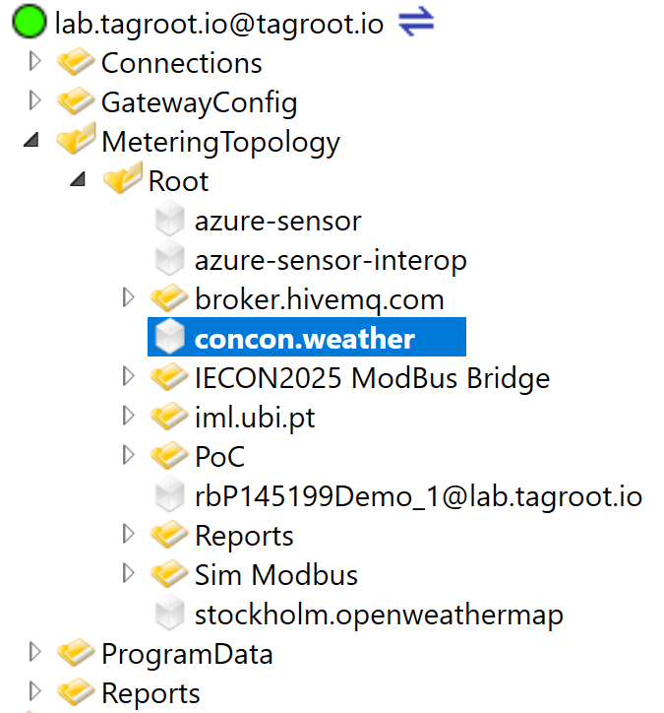
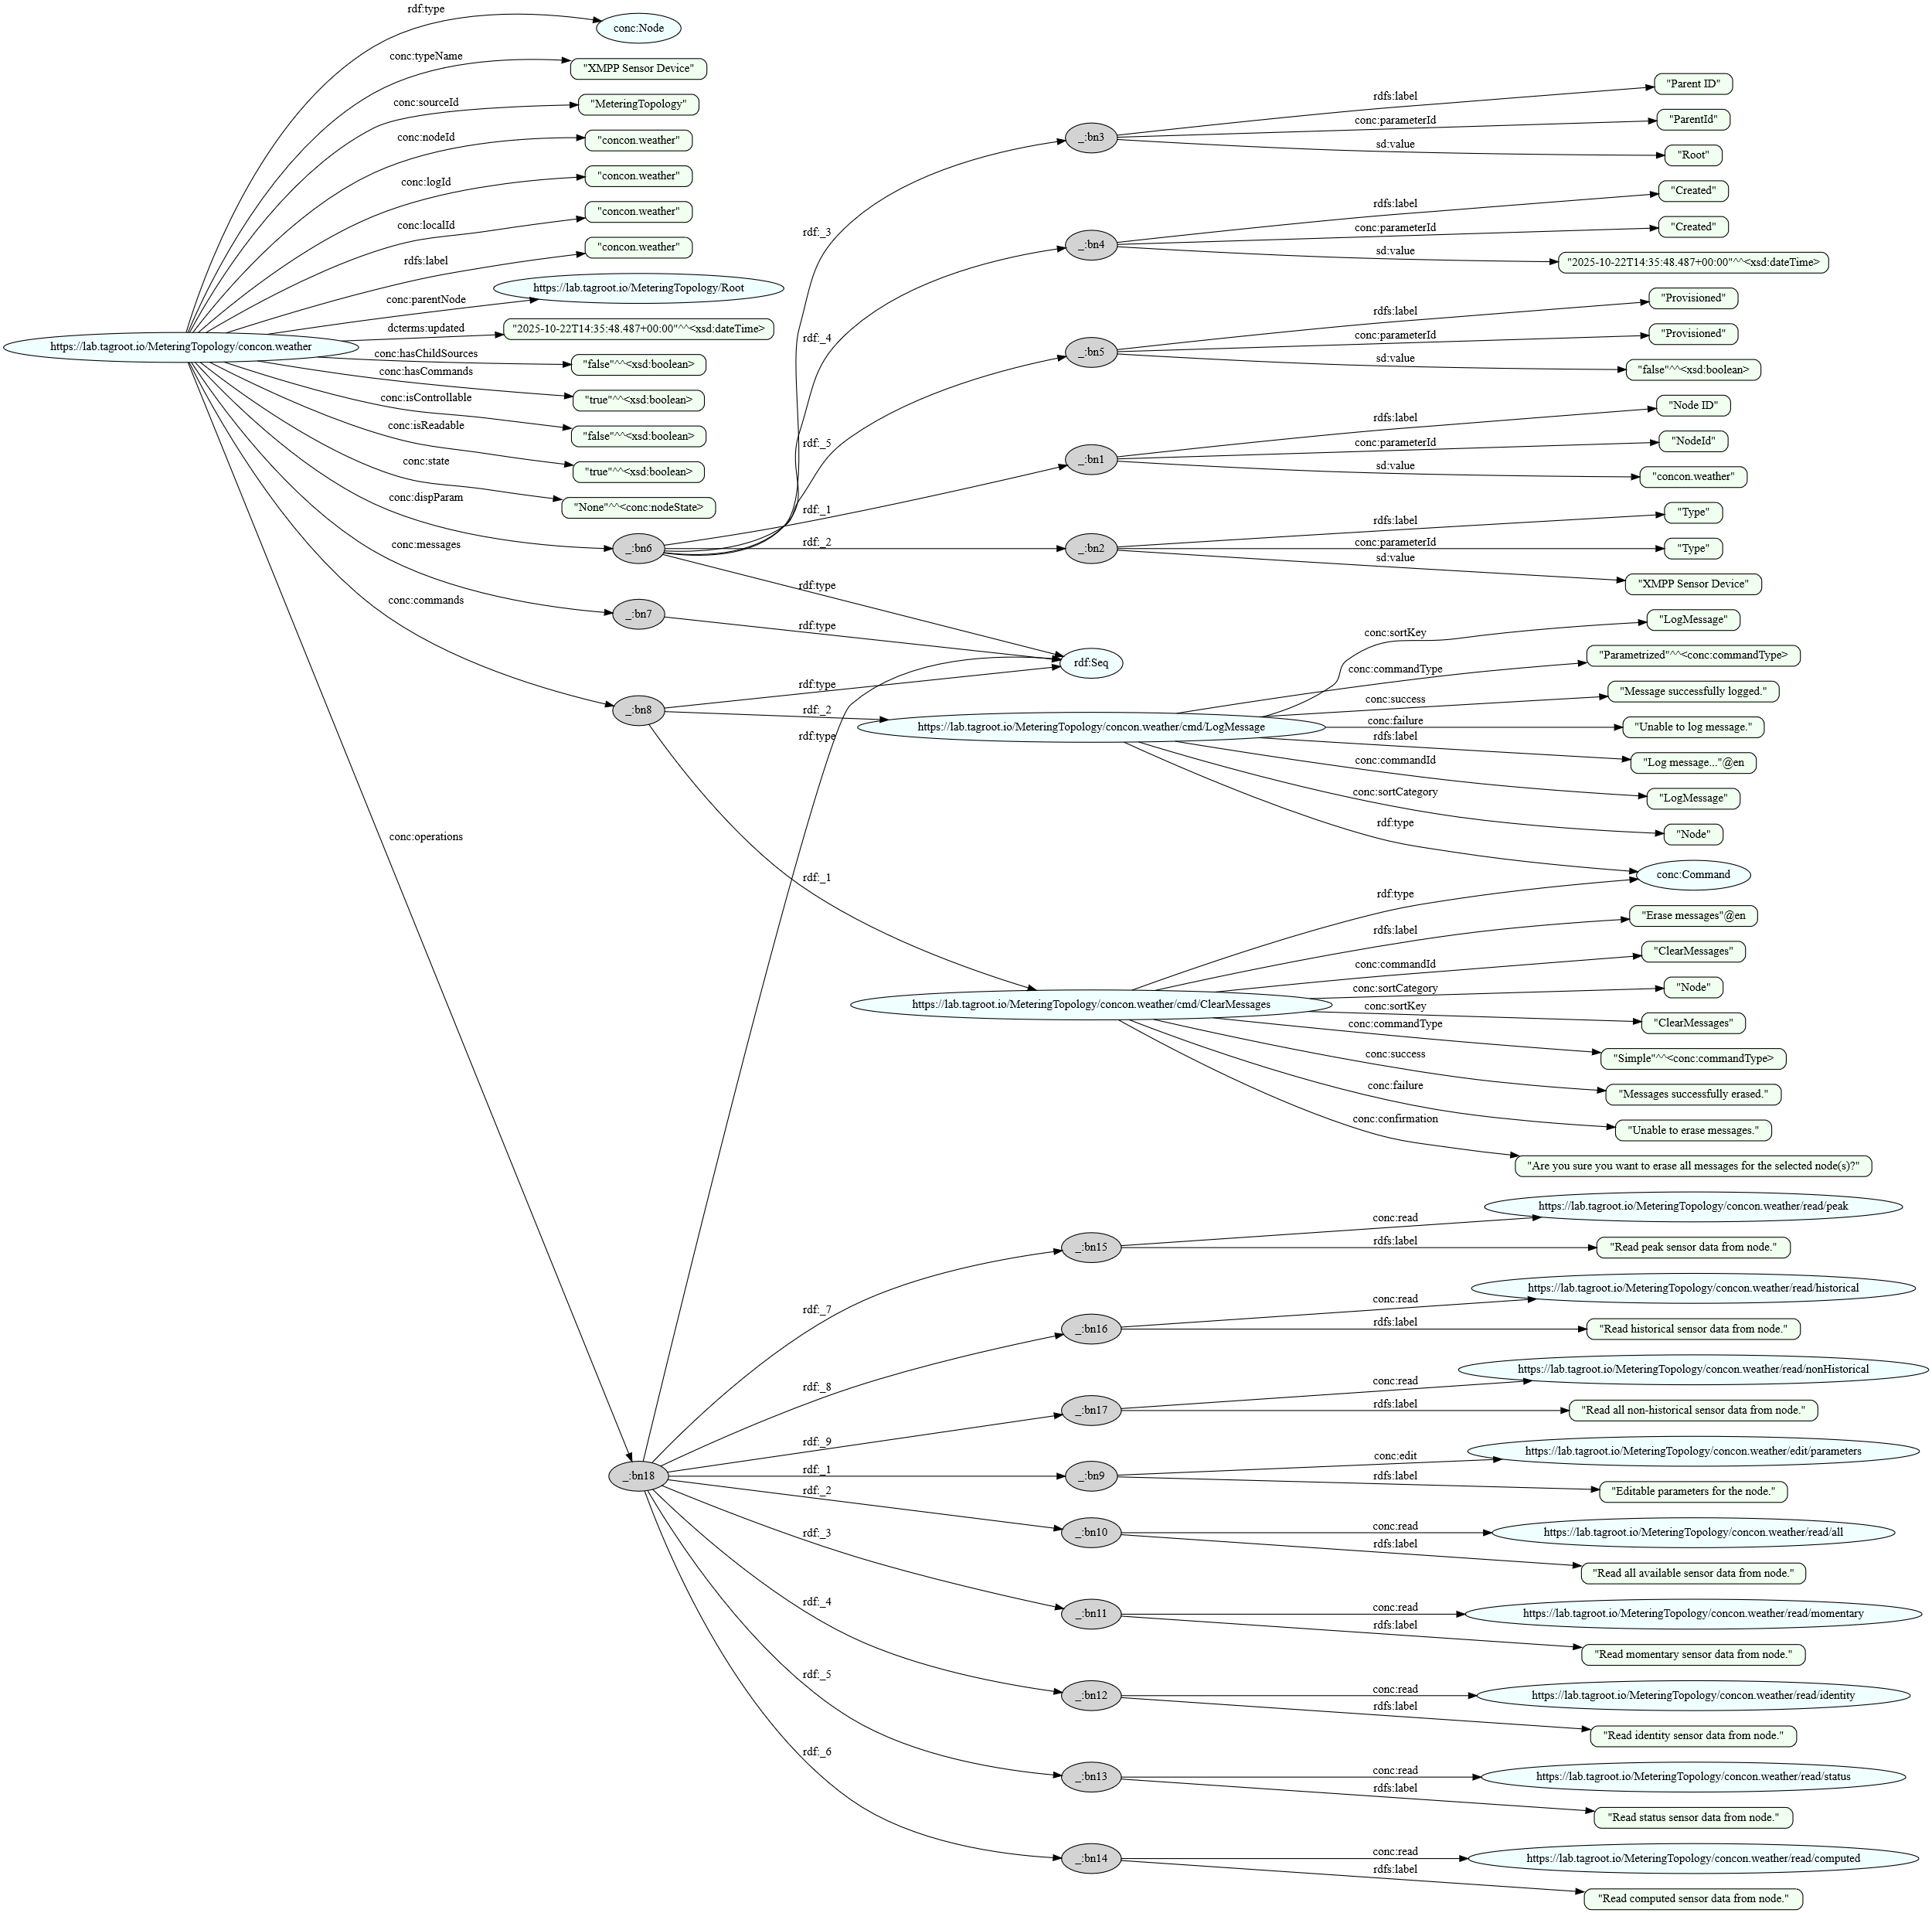
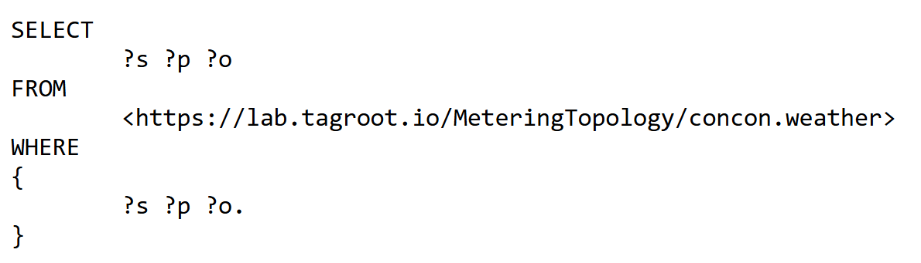
SPARQL Examples – Node (Sensor)
https://lab.tagroot.io/Demo/SparqlExamples.txt
https://lab.tagroot.io/Sparql.md
https://www.w3.org/2013/data/
Notes:
```dot: Incentivising the development of the Smart City
digraph G {
bgcolor="transparent"
node [fillcolor=white,style="filled,solid"]
"cybercity.online" -> "Neuro-Foundation IoT Harmonization"
"Neuro-Foundation IoT Harmonization" [URL="#neuroFoundationIotHarmonization"]
"Neuro-Foundation IoT Harmonization" -> "Open Standards"
"Neuro-Foundation IoT Harmonization" -> "Federation"
"Neuro-Foundation IoT Harmonization" -> "Protocol Bridging"
"Open Standards" [URL="#openStandards"]
"Open Standards" -> "Interoperability"
"Protocol Bridging" [URL="#protocolBridging"]
"Protocol Bridging" -> "Interoperability"
"Federation" [URL="#federation"]
"Federation" -> "Global Identities"
"Federation" -> "Topology Independence"
"Federation" -> "Global Scalability"
"Federation" -> "Ubiquitous Encryption"
"Topology Independence" [URL="#topologyIndependence"]
"Topology Independence" -> "Resilience"
"Global Scalability" [URL="#globalScalability"]
"Global Scalability" -> "Resilience"
"Global Identities" -> "Secure Registration"
"Global Identities" -> "Authentication"
"Authentication" [URL="#authentication"]
"Authentication" -> "Consent"
"Consent" [URL="#consent"]
"Consent" -> "Authorization"
"Global Identities" [URL="#globalIdentities"]
"Global Identities" -> "Discovery"
"Discovery" [URL="#discovery"]
"Discovery" -> "Ownership"
"Ownership" [URL="#ownership"]
"Ownership" -> "Decision Support"
"Authorization" [URL="#authorization"]
"Authorization" -> "Decision Support"
"Resilience" [URL="#resilience"]
"Resilience" -> "Security"
"Secure Registration" [URL="#secureRegistration"]
"Secure Registration" -> "Security"
"Authentication" -> "Security"
"Authorization" -> "Security"
"Ubiquitous Encryption" [URL="#ubiquitousEncryption"]
"Ubiquitous Encryption" -> "Security"
"Decision Support" [URL="#decisionSupport"]
"Decision Support" -> "Security"
"Decision Support" -> "Edge Computing"
"Edge Computing" [URL="#edgeComputing"]
"Edge Computing" -> "Privacy"
"Interoperability" [URL="#interoperability"]
"Interoperability" -> "Contracts"
"Decision Support" -> "Contracts"
"Privacy" [URL="#privacy"]
"Privacy" -> "Marketplace of Things and Data"
"Security" [URL="#security"]
"Security" -> "Marketplace of Things and Data"
"Contracts" [URL="#contracts"]
"Contracts" -> "Marketplace of Things and Data"
"Marketplace of Things and Data" [URL="#marketplaceOfThingsAndData"]
"Marketplace of Things and Data" -> "Economic Feedback"
"Economic Feedback" [URL="#economicFeedback"]
"Economic Feedback" -> "Incentives to develop the Smart City"
"Incentives to develop the Smart City" [URL="#incentivesToDevelopTheSmartCity"]
}
```

Slide 13
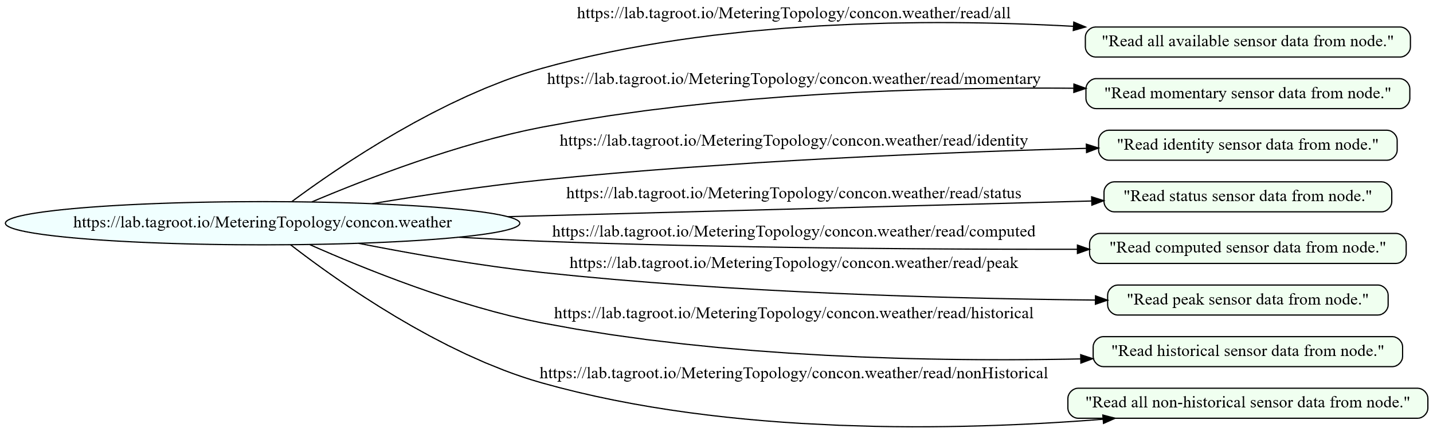
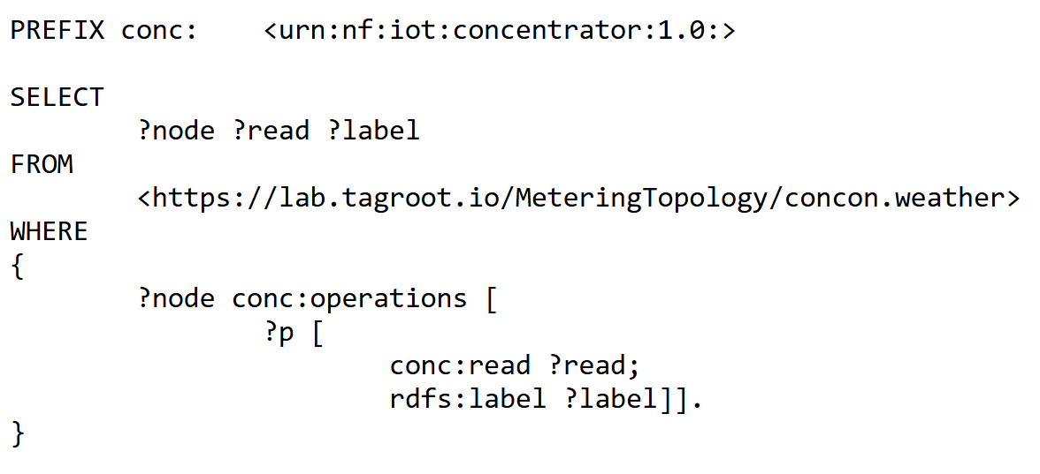
SPARQL Examples – Pattern Matching
https://lab.tagroot.io/Demo/SparqlExamples.txt
https://lab.tagroot.io/Sparql.md
https://www.w3.org/2013/data/
Notes:
```dot: Incentivising the development of the Smart City
digraph G {
bgcolor="transparent"
node [fillcolor=white,style="filled,solid"]
"cybercity.online" -> "Neuro-Foundation IoT Harmonization"
"Neuro-Foundation IoT Harmonization" [URL="#neuroFoundationIotHarmonization"]
"Neuro-Foundation IoT Harmonization" -> "Open Standards"
"Neuro-Foundation IoT Harmonization" -> "Federation"
"Neuro-Foundation IoT Harmonization" -> "Protocol Bridging"
"Open Standards" [URL="#openStandards"]
"Open Standards" -> "Interoperability"
"Protocol Bridging" [URL="#protocolBridging"]
"Protocol Bridging" -> "Interoperability"
"Federation" [URL="#federation"]
"Federation" -> "Global Identities"
"Federation" -> "Topology Independence"
"Federation" -> "Global Scalability"
"Federation" -> "Ubiquitous Encryption"
"Topology Independence" [URL="#topologyIndependence"]
"Topology Independence" -> "Resilience"
"Global Scalability" [URL="#globalScalability"]
"Global Scalability" -> "Resilience"
"Global Identities" -> "Secure Registration"
"Global Identities" -> "Authentication"
"Authentication" [URL="#authentication"]
"Authentication" -> "Consent"
"Consent" [URL="#consent"]
"Consent" -> "Authorization"
"Global Identities" [URL="#globalIdentities"]
"Global Identities" -> "Discovery"
"Discovery" [URL="#discovery"]
"Discovery" -> "Ownership"
"Ownership" [URL="#ownership"]
"Ownership" -> "Decision Support"
"Authorization" [URL="#authorization"]
"Authorization" -> "Decision Support"
"Resilience" [URL="#resilience"]
"Resilience" -> "Security"
"Secure Registration" [URL="#secureRegistration"]
"Secure Registration" -> "Security"
"Authentication" -> "Security"
"Authorization" -> "Security"
"Ubiquitous Encryption" [URL="#ubiquitousEncryption"]
"Ubiquitous Encryption" -> "Security"
"Decision Support" [URL="#decisionSupport"]
"Decision Support" -> "Security"
"Decision Support" -> "Edge Computing"
"Edge Computing" [URL="#edgeComputing"]
"Edge Computing" -> "Privacy"
"Interoperability" [URL="#interoperability"]
"Interoperability" -> "Contracts"
"Decision Support" -> "Contracts"
"Privacy" [URL="#privacy"]
"Privacy" -> "Marketplace of Things and Data"
"Security" [URL="#security"]
"Security" -> "Marketplace of Things and Data"
"Contracts" [URL="#contracts"]
"Contracts" -> "Marketplace of Things and Data"
"Marketplace of Things and Data" [URL="#marketplaceOfThingsAndData"]
"Marketplace of Things and Data" -> "Economic Feedback"
"Economic Feedback" [URL="#economicFeedback"]
"Economic Feedback" -> "Incentives to develop the Smart City"
"Incentives to develop the Smart City" [URL="#incentivesToDevelopTheSmartCity"]
}
```

Slide 14
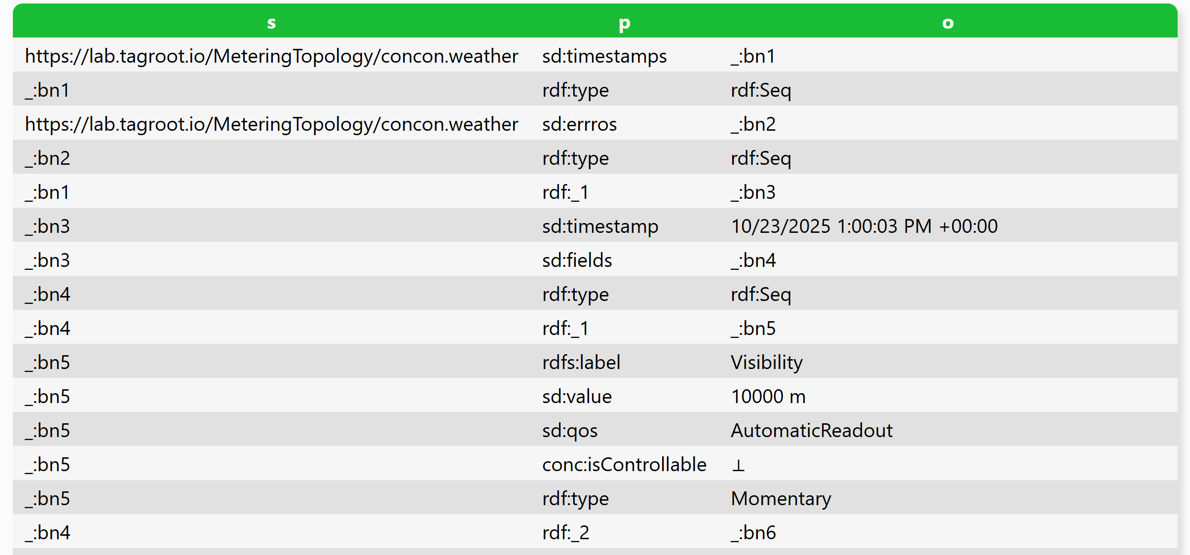
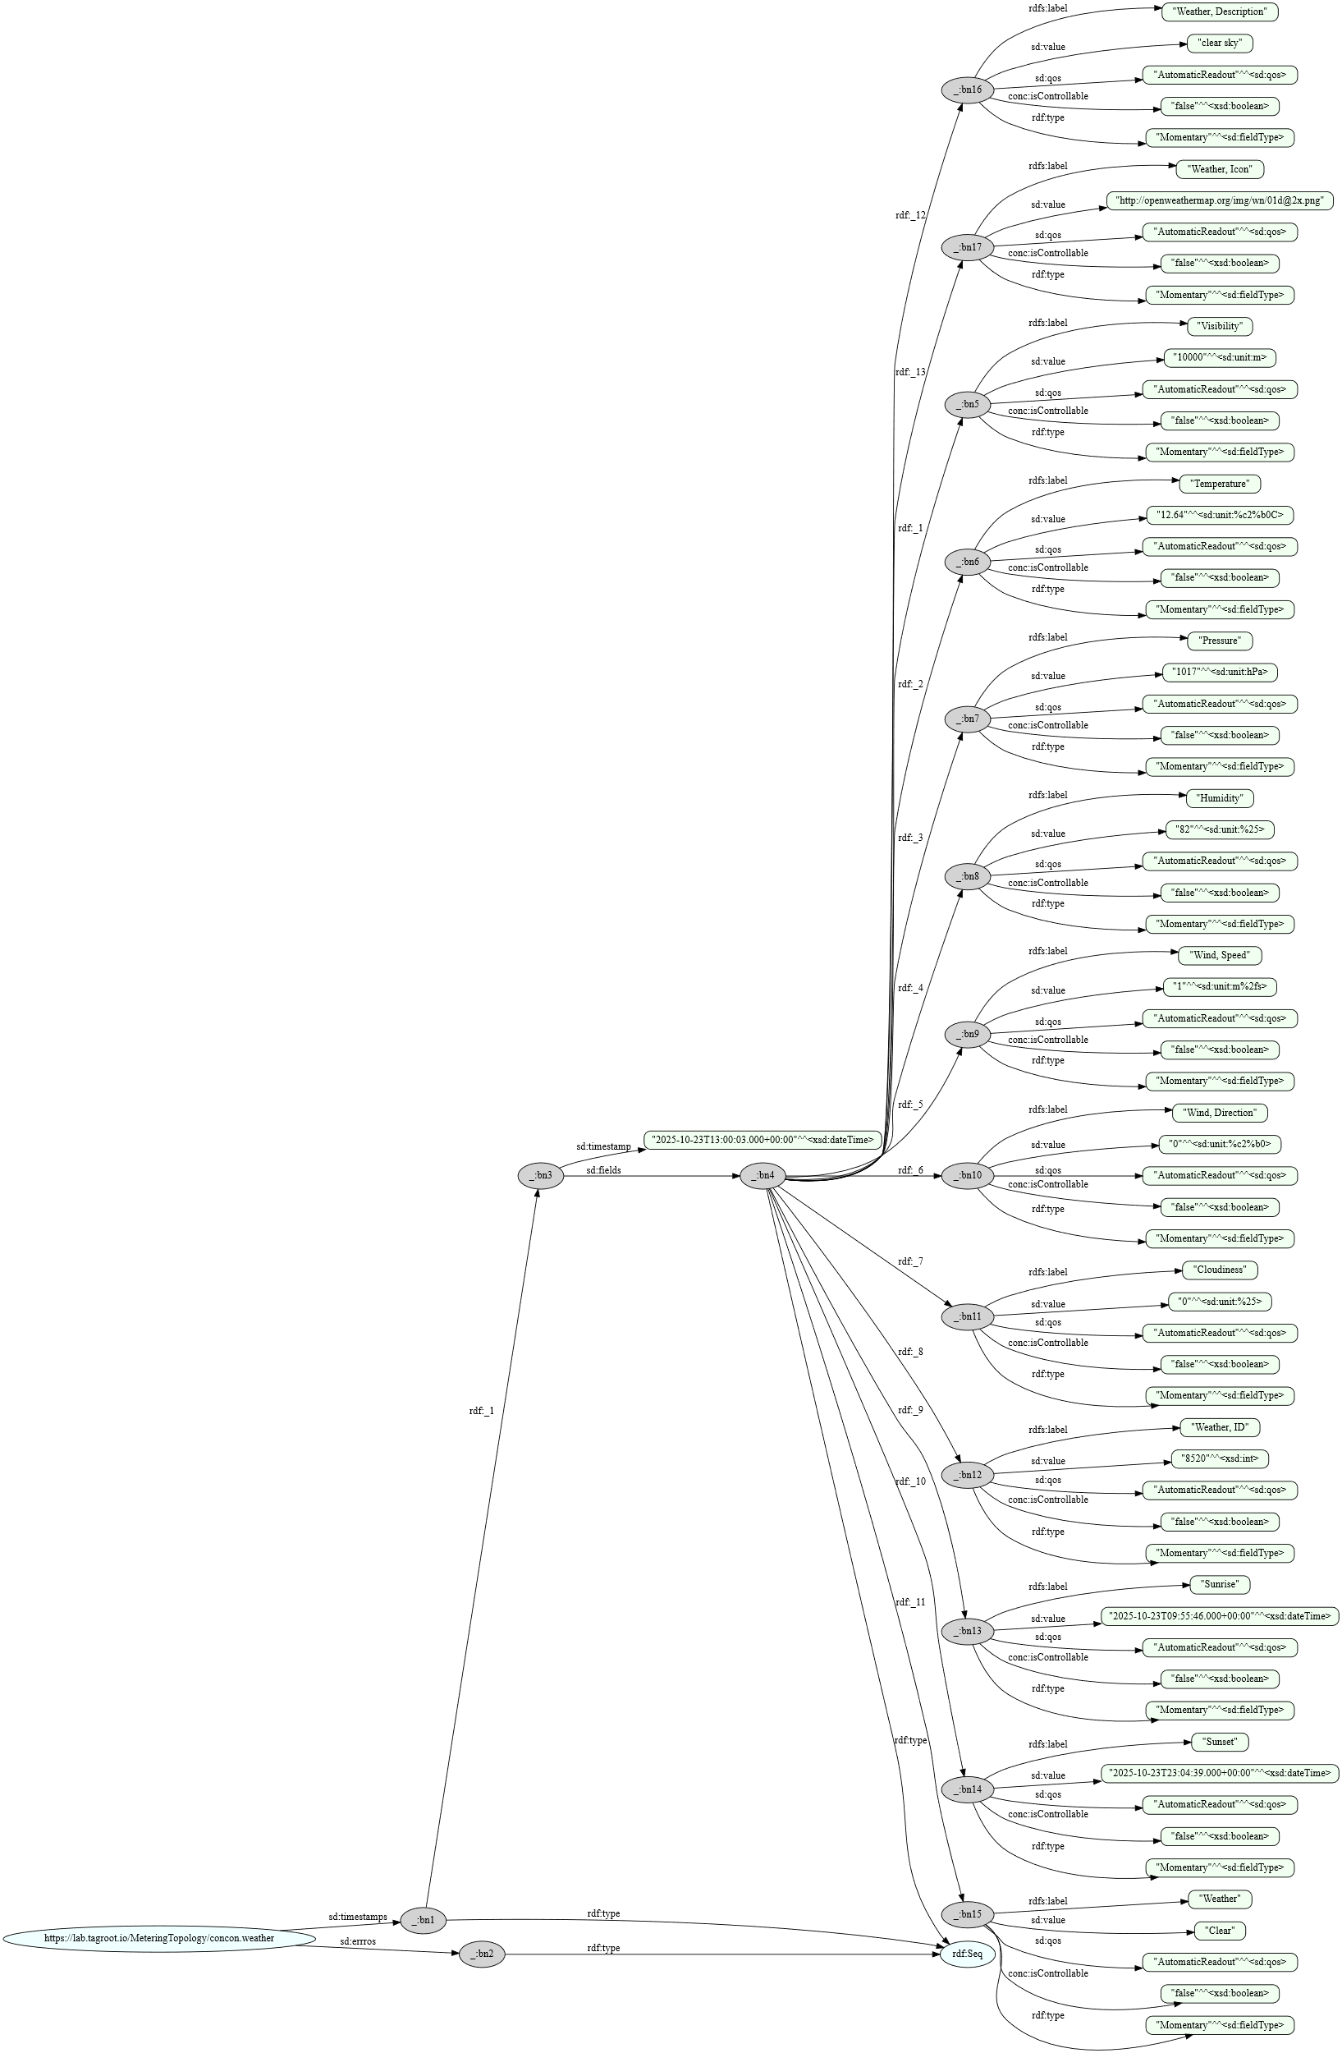
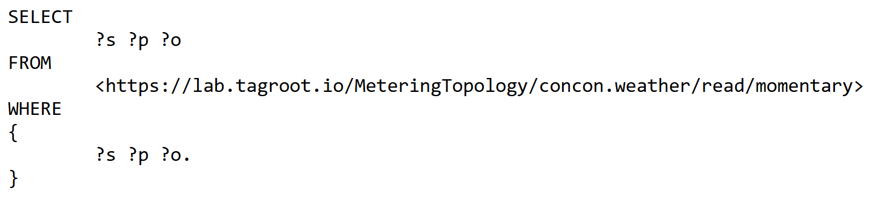
SPARQL Examples – Reading Sensor (1)
https://lab.tagroot.io/Demo/SparqlExamples.txt
https://lab.tagroot.io/Sparql.md
https://www.w3.org/2013/data/
Notes:
```dot: Incentivising the development of the Smart City
digraph G {
bgcolor="transparent"
node [fillcolor=white,style="filled,solid"]
"cybercity.online" -> "Neuro-Foundation IoT Harmonization"
"Neuro-Foundation IoT Harmonization" [URL="#neuroFoundationIotHarmonization"]
"Neuro-Foundation IoT Harmonization" -> "Open Standards"
"Neuro-Foundation IoT Harmonization" -> "Federation"
"Neuro-Foundation IoT Harmonization" -> "Protocol Bridging"
"Open Standards" [URL="#openStandards"]
"Open Standards" -> "Interoperability"
"Protocol Bridging" [URL="#protocolBridging"]
"Protocol Bridging" -> "Interoperability"
"Federation" [URL="#federation"]
"Federation" -> "Global Identities"
"Federation" -> "Topology Independence"
"Federation" -> "Global Scalability"
"Federation" -> "Ubiquitous Encryption"
"Topology Independence" [URL="#topologyIndependence"]
"Topology Independence" -> "Resilience"
"Global Scalability" [URL="#globalScalability"]
"Global Scalability" -> "Resilience"
"Global Identities" -> "Secure Registration"
"Global Identities" -> "Authentication"
"Authentication" [URL="#authentication"]
"Authentication" -> "Consent"
"Consent" [URL="#consent"]
"Consent" -> "Authorization"
"Global Identities" [URL="#globalIdentities"]
"Global Identities" -> "Discovery"
"Discovery" [URL="#discovery"]
"Discovery" -> "Ownership"
"Ownership" [URL="#ownership"]
"Ownership" -> "Decision Support"
"Authorization" [URL="#authorization"]
"Authorization" -> "Decision Support"
"Resilience" [URL="#resilience"]
"Resilience" -> "Security"
"Secure Registration" [URL="#secureRegistration"]
"Secure Registration" -> "Security"
"Authentication" -> "Security"
"Authorization" -> "Security"
"Ubiquitous Encryption" [URL="#ubiquitousEncryption"]
"Ubiquitous Encryption" -> "Security"
"Decision Support" [URL="#decisionSupport"]
"Decision Support" -> "Security"
"Decision Support" -> "Edge Computing"
"Edge Computing" [URL="#edgeComputing"]
"Edge Computing" -> "Privacy"
"Interoperability" [URL="#interoperability"]
"Interoperability" -> "Contracts"
"Decision Support" -> "Contracts"
"Privacy" [URL="#privacy"]
"Privacy" -> "Marketplace of Things and Data"
"Security" [URL="#security"]
"Security" -> "Marketplace of Things and Data"
"Contracts" [URL="#contracts"]
"Contracts" -> "Marketplace of Things and Data"
"Marketplace of Things and Data" [URL="#marketplaceOfThingsAndData"]
"Marketplace of Things and Data" -> "Economic Feedback"
"Economic Feedback" [URL="#economicFeedback"]
"Economic Feedback" -> "Incentives to develop the Smart City"
"Incentives to develop the Smart City" [URL="#incentivesToDevelopTheSmartCity"]
}
```

Slide 15
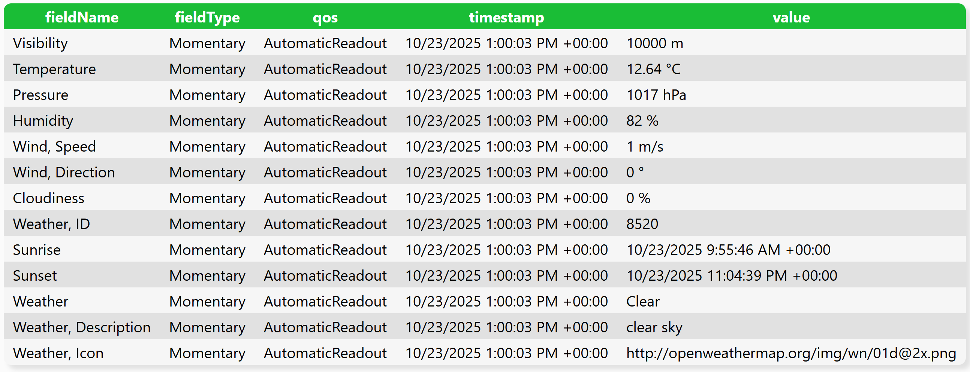
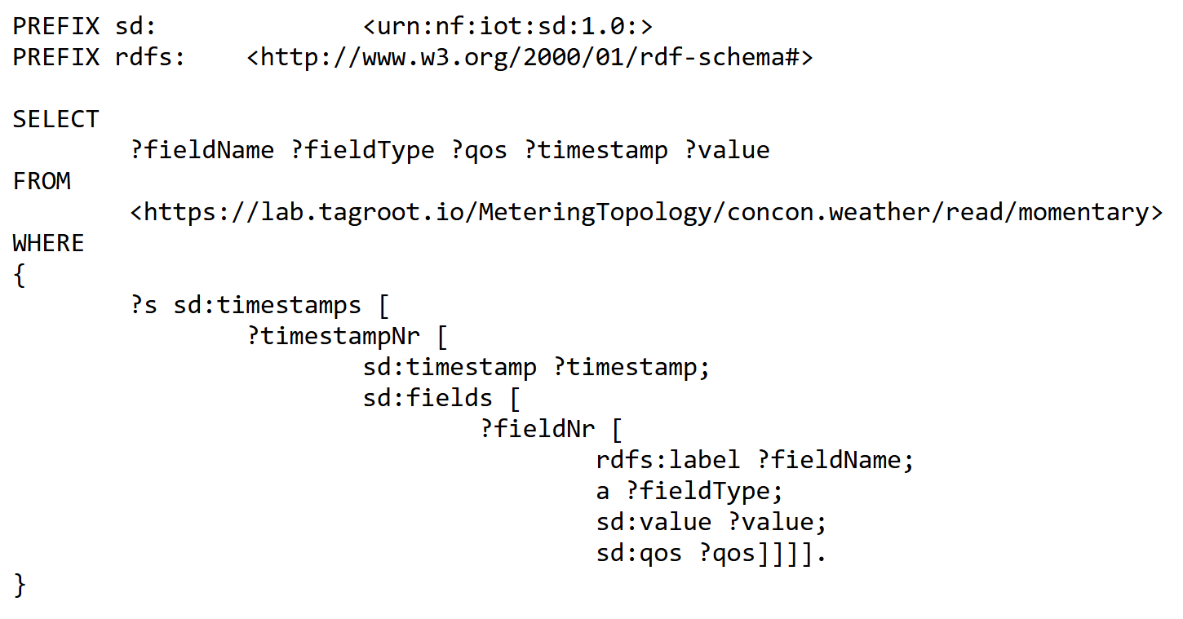
SPARQL Examples – Reading Sensor (2)
https://lab.tagroot.io/Demo/SparqlExamples.txt
https://lab.tagroot.io/Sparql.md
https://www.w3.org/2013/data/
Notes:
```dot: Incentivising the development of the Smart City
digraph G {
bgcolor="transparent"
node [fillcolor=white,style="filled,solid"]
"cybercity.online" -> "Neuro-Foundation IoT Harmonization"
"Neuro-Foundation IoT Harmonization" [URL="#neuroFoundationIotHarmonization"]
"Neuro-Foundation IoT Harmonization" -> "Open Standards"
"Neuro-Foundation IoT Harmonization" -> "Federation"
"Neuro-Foundation IoT Harmonization" -> "Protocol Bridging"
"Open Standards" [URL="#openStandards"]
"Open Standards" -> "Interoperability"
"Protocol Bridging" [URL="#protocolBridging"]
"Protocol Bridging" -> "Interoperability"
"Federation" [URL="#federation"]
"Federation" -> "Global Identities"
"Federation" -> "Topology Independence"
"Federation" -> "Global Scalability"
"Federation" -> "Ubiquitous Encryption"
"Topology Independence" [URL="#topologyIndependence"]
"Topology Independence" -> "Resilience"
"Global Scalability" [URL="#globalScalability"]
"Global Scalability" -> "Resilience"
"Global Identities" -> "Secure Registration"
"Global Identities" -> "Authentication"
"Authentication" [URL="#authentication"]
"Authentication" -> "Consent"
"Consent" [URL="#consent"]
"Consent" -> "Authorization"
"Global Identities" [URL="#globalIdentities"]
"Global Identities" -> "Discovery"
"Discovery" [URL="#discovery"]
"Discovery" -> "Ownership"
"Ownership" [URL="#ownership"]
"Ownership" -> "Decision Support"
"Authorization" [URL="#authorization"]
"Authorization" -> "Decision Support"
"Resilience" [URL="#resilience"]
"Resilience" -> "Security"
"Secure Registration" [URL="#secureRegistration"]
"Secure Registration" -> "Security"
"Authentication" -> "Security"
"Authorization" -> "Security"
"Ubiquitous Encryption" [URL="#ubiquitousEncryption"]
"Ubiquitous Encryption" -> "Security"
"Decision Support" [URL="#decisionSupport"]
"Decision Support" -> "Security"
"Decision Support" -> "Edge Computing"
"Edge Computing" [URL="#edgeComputing"]
"Edge Computing" -> "Privacy"
"Interoperability" [URL="#interoperability"]
"Interoperability" -> "Contracts"
"Decision Support" -> "Contracts"
"Privacy" [URL="#privacy"]
"Privacy" -> "Marketplace of Things and Data"
"Security" [URL="#security"]
"Security" -> "Marketplace of Things and Data"
"Contracts" [URL="#contracts"]
"Contracts" -> "Marketplace of Things and Data"
"Marketplace of Things and Data" [URL="#marketplaceOfThingsAndData"]
"Marketplace of Things and Data" -> "Economic Feedback"
"Economic Feedback" [URL="#economicFeedback"]
"Economic Feedback" -> "Incentives to develop the Smart City"
"Incentives to develop the Smart City" [URL="#incentivesToDevelopTheSmartCity"]
}
```

Slide 16
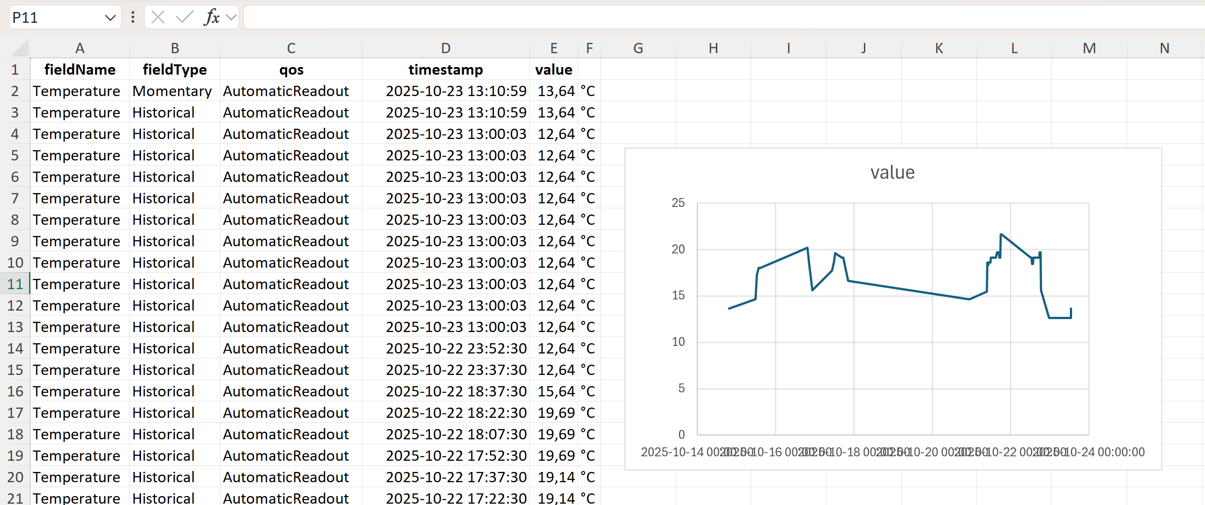
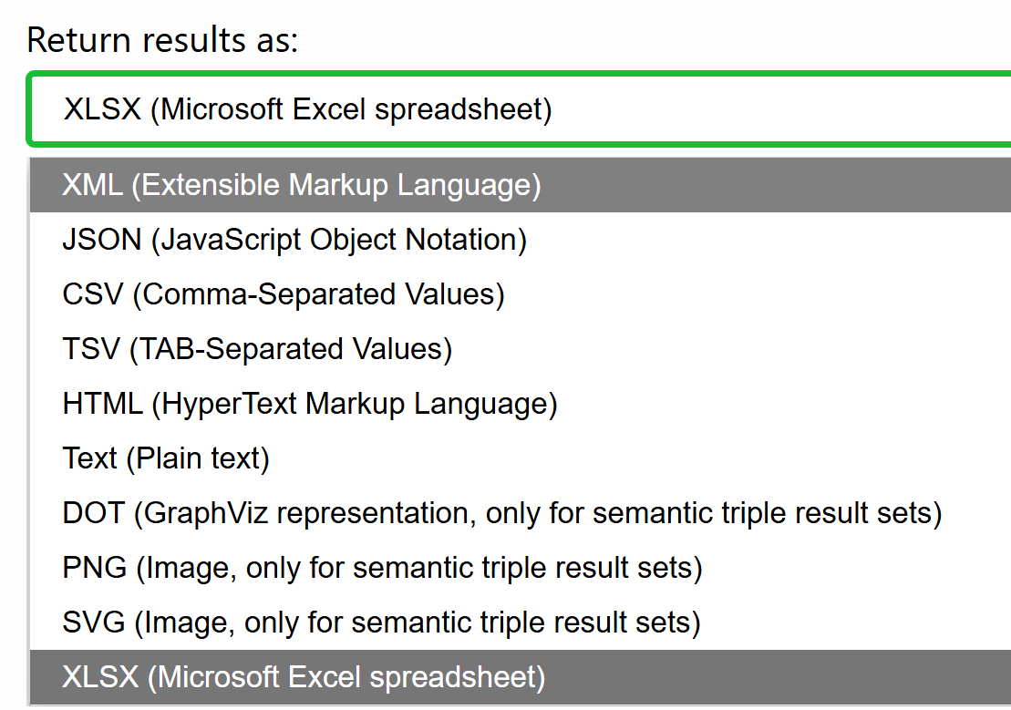
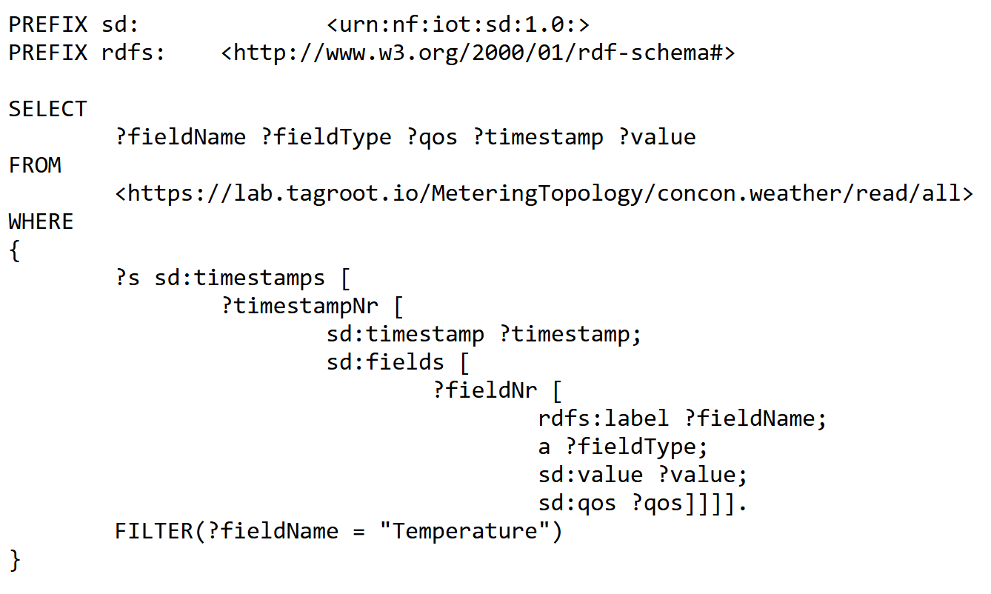
SPARQL Examples – Reading Sensor (3)
https://lab.tagroot.io/Demo/SparqlExamples.txt
https://lab.tagroot.io/Sparql.md
https://www.w3.org/2013/data/
Notes:
```dot: Incentivising the development of the Smart City
digraph G {
bgcolor="transparent"
node [fillcolor=white,style="filled,solid"]
"cybercity.online" -> "Neuro-Foundation IoT Harmonization"
"Neuro-Foundation IoT Harmonization" [URL="#neuroFoundationIotHarmonization"]
"Neuro-Foundation IoT Harmonization" -> "Open Standards"
"Neuro-Foundation IoT Harmonization" -> "Federation"
"Neuro-Foundation IoT Harmonization" -> "Protocol Bridging"
"Open Standards" [URL="#openStandards"]
"Open Standards" -> "Interoperability"
"Protocol Bridging" [URL="#protocolBridging"]
"Protocol Bridging" -> "Interoperability"
"Federation" [URL="#federation"]
"Federation" -> "Global Identities"
"Federation" -> "Topology Independence"
"Federation" -> "Global Scalability"
"Federation" -> "Ubiquitous Encryption"
"Topology Independence" [URL="#topologyIndependence"]
"Topology Independence" -> "Resilience"
"Global Scalability" [URL="#globalScalability"]
"Global Scalability" -> "Resilience"
"Global Identities" -> "Secure Registration"
"Global Identities" -> "Authentication"
"Authentication" [URL="#authentication"]
"Authentication" -> "Consent"
"Consent" [URL="#consent"]
"Consent" -> "Authorization"
"Global Identities" [URL="#globalIdentities"]
"Global Identities" -> "Discovery"
"Discovery" [URL="#discovery"]
"Discovery" -> "Ownership"
"Ownership" [URL="#ownership"]
"Ownership" -> "Decision Support"
"Authorization" [URL="#authorization"]
"Authorization" -> "Decision Support"
"Resilience" [URL="#resilience"]
"Resilience" -> "Security"
"Secure Registration" [URL="#secureRegistration"]
"Secure Registration" -> "Security"
"Authentication" -> "Security"
"Authorization" -> "Security"
"Ubiquitous Encryption" [URL="#ubiquitousEncryption"]
"Ubiquitous Encryption" -> "Security"
"Decision Support" [URL="#decisionSupport"]
"Decision Support" -> "Security"
"Decision Support" -> "Edge Computing"
"Edge Computing" [URL="#edgeComputing"]
"Edge Computing" -> "Privacy"
"Interoperability" [URL="#interoperability"]
"Interoperability" -> "Contracts"
"Decision Support" -> "Contracts"
"Privacy" [URL="#privacy"]
"Privacy" -> "Marketplace of Things and Data"
"Security" [URL="#security"]
"Security" -> "Marketplace of Things and Data"
"Contracts" [URL="#contracts"]
"Contracts" -> "Marketplace of Things and Data"
"Marketplace of Things and Data" [URL="#marketplaceOfThingsAndData"]
"Marketplace of Things and Data" -> "Economic Feedback"
"Economic Feedback" [URL="#economicFeedback"]
"Economic Feedback" -> "Incentives to develop the Smart City"
"Incentives to develop the Smart City" [URL="#incentivesToDevelopTheSmartCity"]
}
```

Slide 17
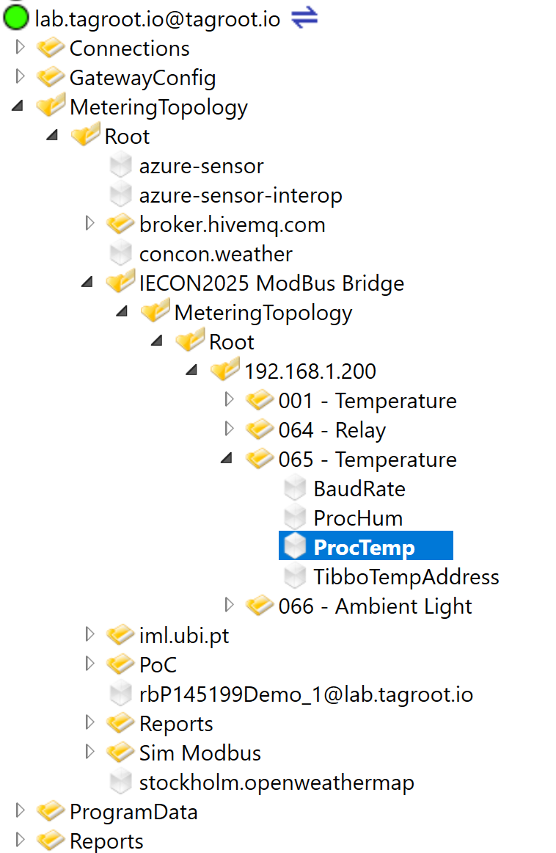
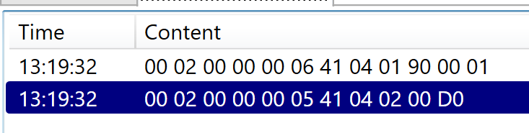
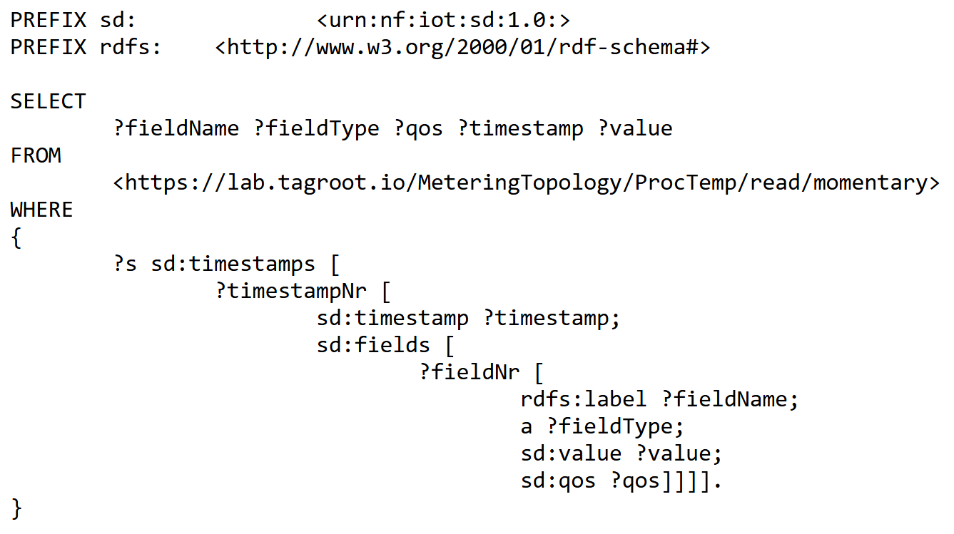
SPARQL Examples – XMPP & Modbus
https://lab.tagroot.io/Demo/SparqlExamples.txt
https://lab.tagroot.io/Sparql.md
https://www.w3.org/2013/data/
Notes:
```dot: Incentivising the development of the Smart City
digraph G {
bgcolor="transparent"
node [fillcolor=white,style="filled,solid"]
"cybercity.online" -> "Neuro-Foundation IoT Harmonization"
"Neuro-Foundation IoT Harmonization" [URL="#neuroFoundationIotHarmonization"]
"Neuro-Foundation IoT Harmonization" -> "Open Standards"
"Neuro-Foundation IoT Harmonization" -> "Federation"
"Neuro-Foundation IoT Harmonization" -> "Protocol Bridging"
"Open Standards" [URL="#openStandards"]
"Open Standards" -> "Interoperability"
"Protocol Bridging" [URL="#protocolBridging"]
"Protocol Bridging" -> "Interoperability"
"Federation" [URL="#federation"]
"Federation" -> "Global Identities"
"Federation" -> "Topology Independence"
"Federation" -> "Global Scalability"
"Federation" -> "Ubiquitous Encryption"
"Topology Independence" [URL="#topologyIndependence"]
"Topology Independence" -> "Resilience"
"Global Scalability" [URL="#globalScalability"]
"Global Scalability" -> "Resilience"
"Global Identities" -> "Secure Registration"
"Global Identities" -> "Authentication"
"Authentication" [URL="#authentication"]
"Authentication" -> "Consent"
"Consent" [URL="#consent"]
"Consent" -> "Authorization"
"Global Identities" [URL="#globalIdentities"]
"Global Identities" -> "Discovery"
"Discovery" [URL="#discovery"]
"Discovery" -> "Ownership"
"Ownership" [URL="#ownership"]
"Ownership" -> "Decision Support"
"Authorization" [URL="#authorization"]
"Authorization" -> "Decision Support"
"Resilience" [URL="#resilience"]
"Resilience" -> "Security"
"Secure Registration" [URL="#secureRegistration"]
"Secure Registration" -> "Security"
"Authentication" -> "Security"
"Authorization" -> "Security"
"Ubiquitous Encryption" [URL="#ubiquitousEncryption"]
"Ubiquitous Encryption" -> "Security"
"Decision Support" [URL="#decisionSupport"]
"Decision Support" -> "Security"
"Decision Support" -> "Edge Computing"
"Edge Computing" [URL="#edgeComputing"]
"Edge Computing" -> "Privacy"
"Interoperability" [URL="#interoperability"]
"Interoperability" -> "Contracts"
"Decision Support" -> "Contracts"
"Privacy" [URL="#privacy"]
"Privacy" -> "Marketplace of Things and Data"
"Security" [URL="#security"]
"Security" -> "Marketplace of Things and Data"
"Contracts" [URL="#contracts"]
"Contracts" -> "Marketplace of Things and Data"
"Marketplace of Things and Data" [URL="#marketplaceOfThingsAndData"]
"Marketplace of Things and Data" -> "Economic Feedback"
"Economic Feedback" [URL="#economicFeedback"]
"Economic Feedback" -> "Incentives to develop the Smart City"
"Incentives to develop the Smart City" [URL="#incentivesToDevelopTheSmartCity"]
}
```

Slide 18
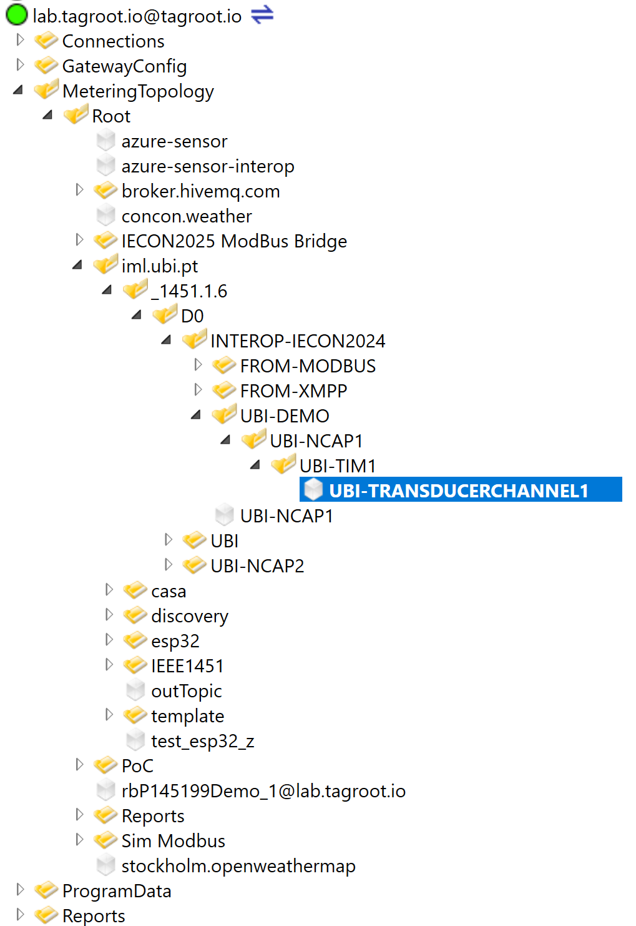
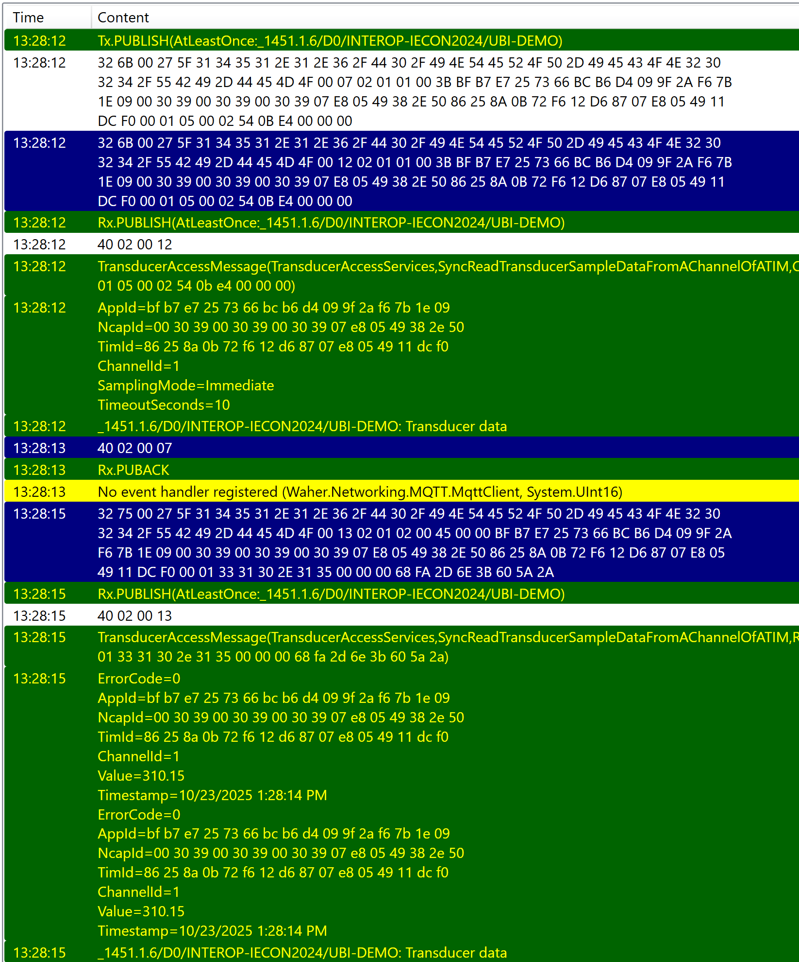
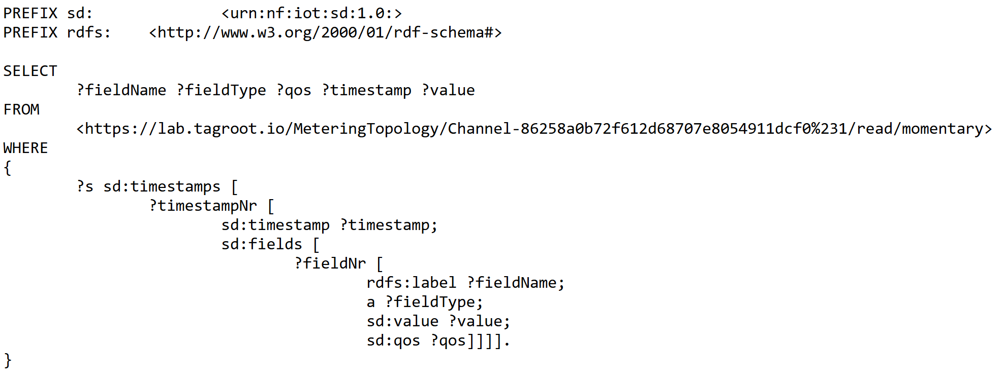
SPARQL Examples – MQTT & IEEE 1451
https://lab.tagroot.io/Demo/SparqlExamples.txt
https://lab.tagroot.io/Sparql.md
https://www.w3.org/2013/data/
Notes:
```dot: Incentivising the development of the Smart City
digraph G {
bgcolor="transparent"
node [fillcolor=white,style="filled,solid"]
"cybercity.online" -> "Neuro-Foundation IoT Harmonization"
"Neuro-Foundation IoT Harmonization" [URL="#neuroFoundationIotHarmonization"]
"Neuro-Foundation IoT Harmonization" -> "Open Standards"
"Neuro-Foundation IoT Harmonization" -> "Federation"
"Neuro-Foundation IoT Harmonization" -> "Protocol Bridging"
"Open Standards" [URL="#openStandards"]
"Open Standards" -> "Interoperability"
"Protocol Bridging" [URL="#protocolBridging"]
"Protocol Bridging" -> "Interoperability"
"Federation" [URL="#federation"]
"Federation" -> "Global Identities"
"Federation" -> "Topology Independence"
"Federation" -> "Global Scalability"
"Federation" -> "Ubiquitous Encryption"
"Topology Independence" [URL="#topologyIndependence"]
"Topology Independence" -> "Resilience"
"Global Scalability" [URL="#globalScalability"]
"Global Scalability" -> "Resilience"
"Global Identities" -> "Secure Registration"
"Global Identities" -> "Authentication"
"Authentication" [URL="#authentication"]
"Authentication" -> "Consent"
"Consent" [URL="#consent"]
"Consent" -> "Authorization"
"Global Identities" [URL="#globalIdentities"]
"Global Identities" -> "Discovery"
"Discovery" [URL="#discovery"]
"Discovery" -> "Ownership"
"Ownership" [URL="#ownership"]
"Ownership" -> "Decision Support"
"Authorization" [URL="#authorization"]
"Authorization" -> "Decision Support"
"Resilience" [URL="#resilience"]
"Resilience" -> "Security"
"Secure Registration" [URL="#secureRegistration"]
"Secure Registration" -> "Security"
"Authentication" -> "Security"
"Authorization" -> "Security"
"Ubiquitous Encryption" [URL="#ubiquitousEncryption"]
"Ubiquitous Encryption" -> "Security"
"Decision Support" [URL="#decisionSupport"]
"Decision Support" -> "Security"
"Decision Support" -> "Edge Computing"
"Edge Computing" [URL="#edgeComputing"]
"Edge Computing" -> "Privacy"
"Interoperability" [URL="#interoperability"]
"Interoperability" -> "Contracts"
"Decision Support" -> "Contracts"
"Privacy" [URL="#privacy"]
"Privacy" -> "Marketplace of Things and Data"
"Security" [URL="#security"]
"Security" -> "Marketplace of Things and Data"
"Contracts" [URL="#contracts"]
"Contracts" -> "Marketplace of Things and Data"
"Marketplace of Things and Data" [URL="#marketplaceOfThingsAndData"]
"Marketplace of Things and Data" -> "Economic Feedback"
"Economic Feedback" [URL="#economicFeedback"]
"Economic Feedback" -> "Incentives to develop the Smart City"
"Incentives to develop the Smart City" [URL="#incentivesToDevelopTheSmartCity"]
}
```

Slide 19
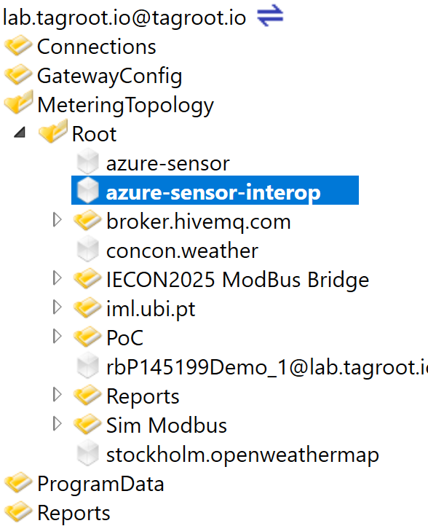
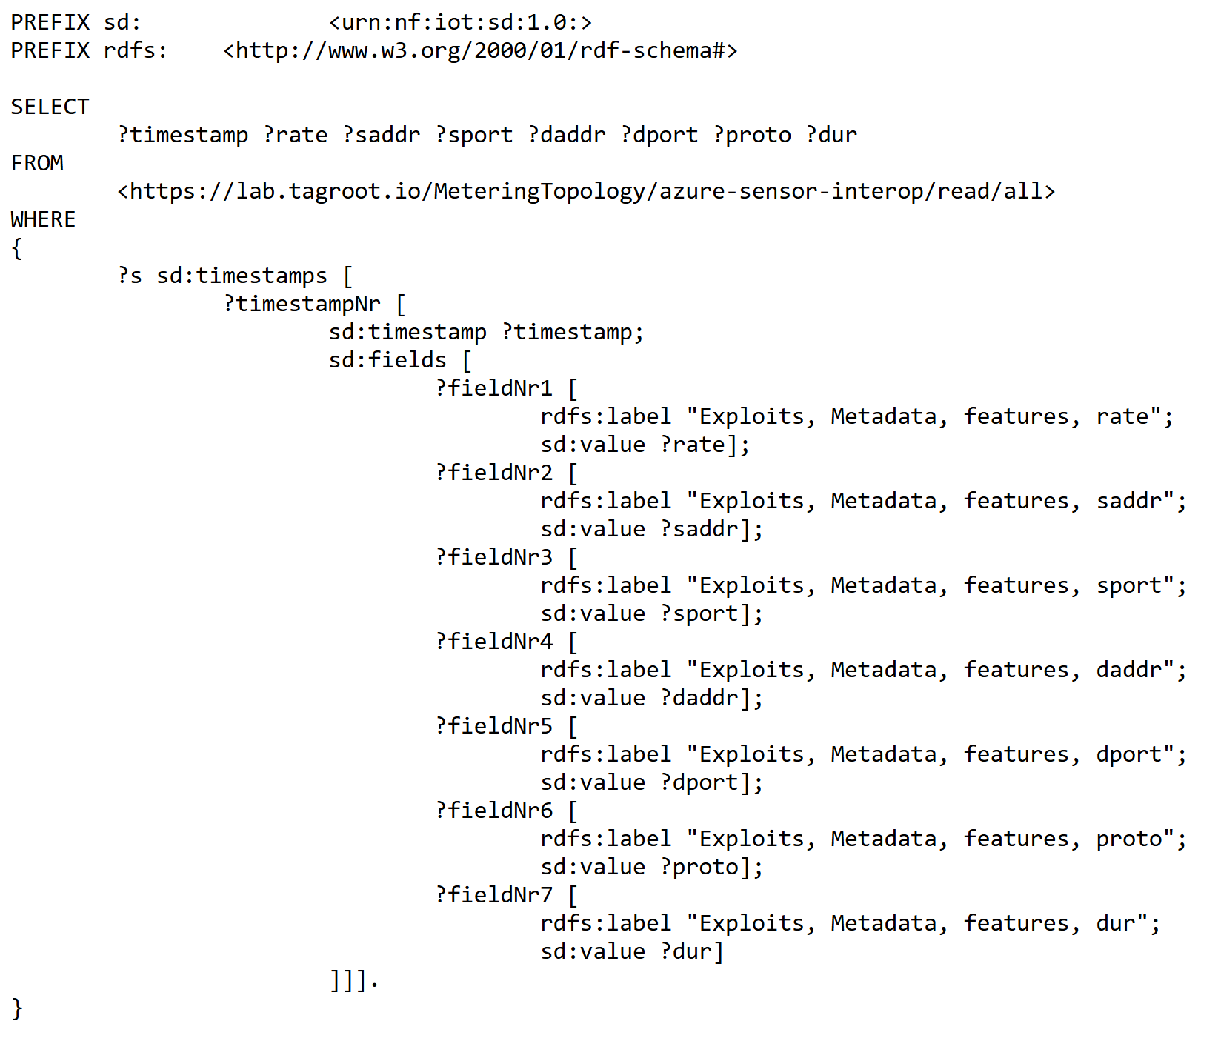
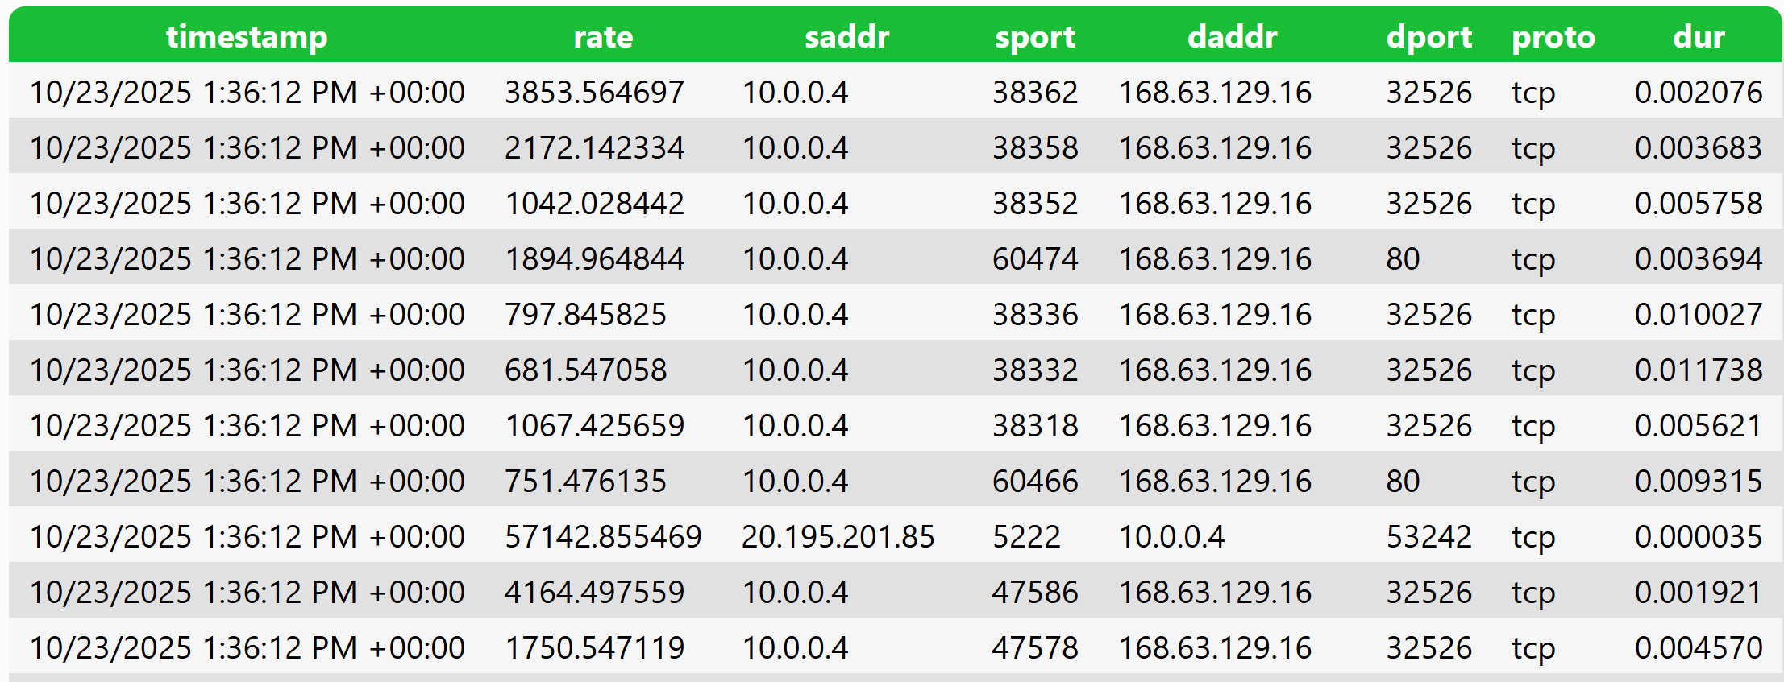
SPARQL Examples – In-transit processing
https://lab.tagroot.io/Demo/SparqlExamples.txt
https://lab.tagroot.io/Sparql.md
https://www.w3.org/2013/data/
Notes:
```dot: Incentivising the development of the Smart City
digraph G {
bgcolor="transparent"
node [fillcolor=white,style="filled,solid"]
"cybercity.online" -> "Neuro-Foundation IoT Harmonization"
"Neuro-Foundation IoT Harmonization" [URL="#neuroFoundationIotHarmonization"]
"Neuro-Foundation IoT Harmonization" -> "Open Standards"
"Neuro-Foundation IoT Harmonization" -> "Federation"
"Neuro-Foundation IoT Harmonization" -> "Protocol Bridging"
"Open Standards" [URL="#openStandards"]
"Open Standards" -> "Interoperability"
"Protocol Bridging" [URL="#protocolBridging"]
"Protocol Bridging" -> "Interoperability"
"Federation" [URL="#federation"]
"Federation" -> "Global Identities"
"Federation" -> "Topology Independence"
"Federation" -> "Global Scalability"
"Federation" -> "Ubiquitous Encryption"
"Topology Independence" [URL="#topologyIndependence"]
"Topology Independence" -> "Resilience"
"Global Scalability" [URL="#globalScalability"]
"Global Scalability" -> "Resilience"
"Global Identities" -> "Secure Registration"
"Global Identities" -> "Authentication"
"Authentication" [URL="#authentication"]
"Authentication" -> "Consent"
"Consent" [URL="#consent"]
"Consent" -> "Authorization"
"Global Identities" [URL="#globalIdentities"]
"Global Identities" -> "Discovery"
"Discovery" [URL="#discovery"]
"Discovery" -> "Ownership"
"Ownership" [URL="#ownership"]
"Ownership" -> "Decision Support"
"Authorization" [URL="#authorization"]
"Authorization" -> "Decision Support"
"Resilience" [URL="#resilience"]
"Resilience" -> "Security"
"Secure Registration" [URL="#secureRegistration"]
"Secure Registration" -> "Security"
"Authentication" -> "Security"
"Authorization" -> "Security"
"Ubiquitous Encryption" [URL="#ubiquitousEncryption"]
"Ubiquitous Encryption" -> "Security"
"Decision Support" [URL="#decisionSupport"]
"Decision Support" -> "Security"
"Decision Support" -> "Edge Computing"
"Edge Computing" [URL="#edgeComputing"]
"Edge Computing" -> "Privacy"
"Interoperability" [URL="#interoperability"]
"Interoperability" -> "Contracts"
"Decision Support" -> "Contracts"
"Privacy" [URL="#privacy"]
"Privacy" -> "Marketplace of Things and Data"
"Security" [URL="#security"]
"Security" -> "Marketplace of Things and Data"
"Contracts" [URL="#contracts"]
"Contracts" -> "Marketplace of Things and Data"
"Marketplace of Things and Data" [URL="#marketplaceOfThingsAndData"]
"Marketplace of Things and Data" -> "Economic Feedback"
"Economic Feedback" [URL="#economicFeedback"]
"Economic Feedback" -> "Incentives to develop the Smart City"
"Incentives to develop the Smart City" [URL="#incentivesToDevelopTheSmartCity"]
}
```

Slide 20
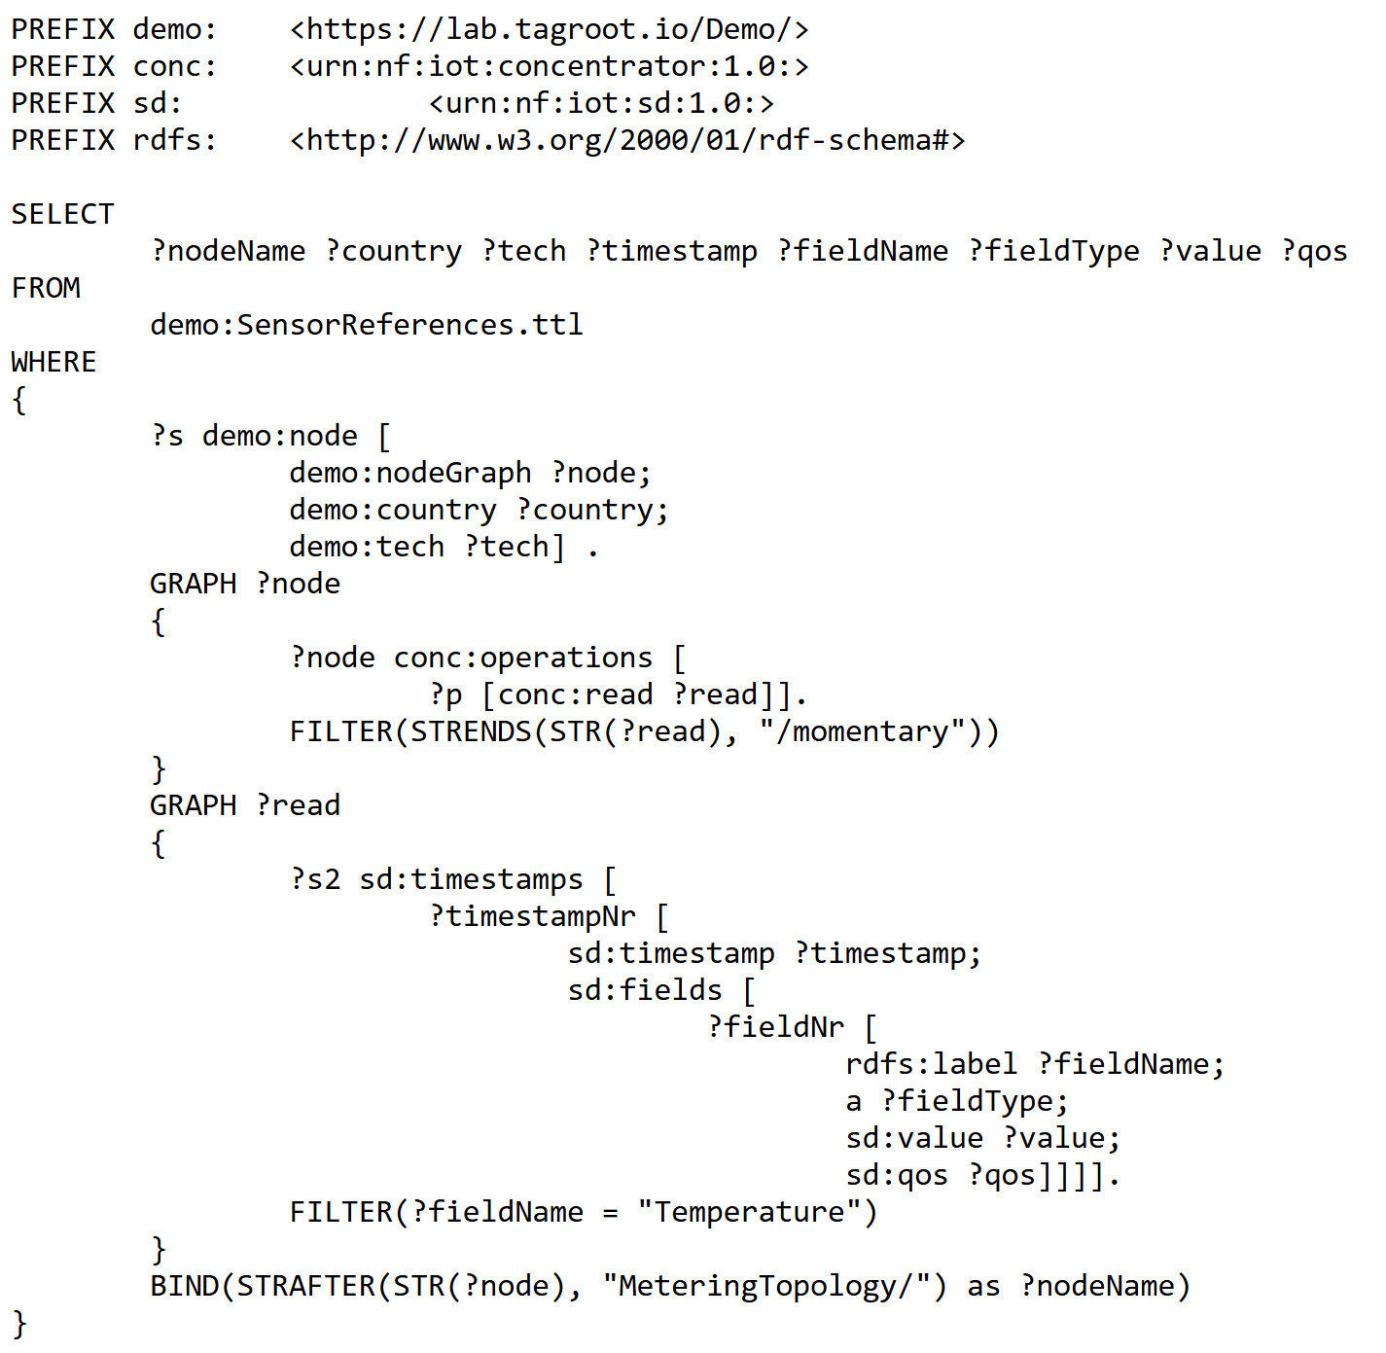
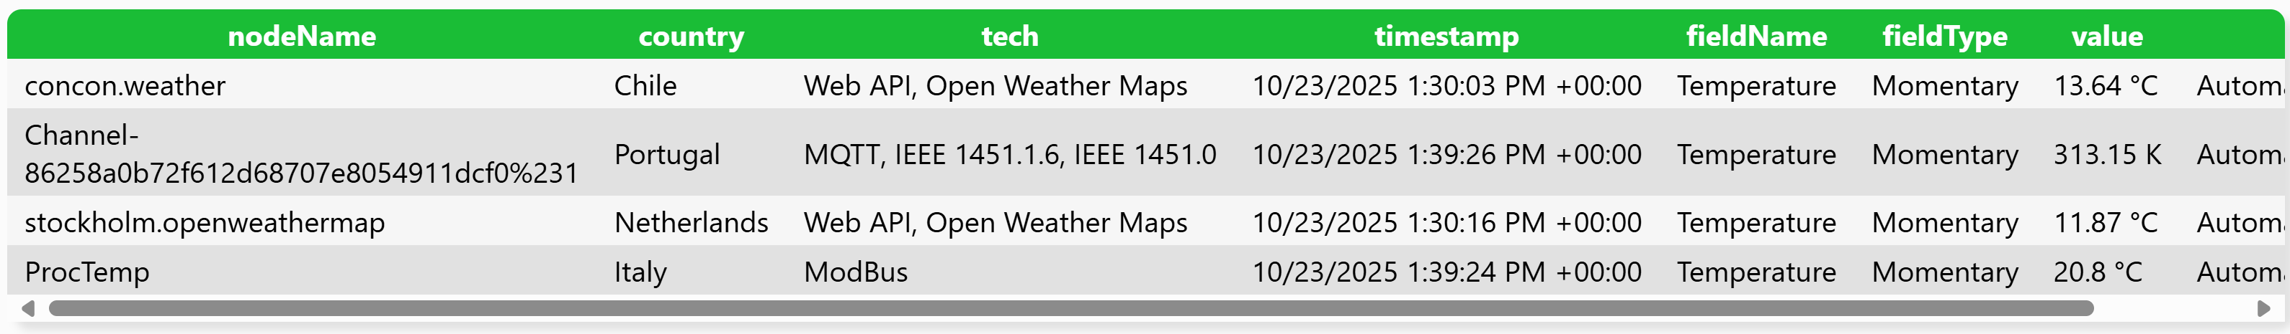
SPARQL Examples – Joining Graphs
https://lab.tagroot.io/Demo/SparqlExamples.txt
https://lab.tagroot.io/Sparql.md
https://www.w3.org/2013/data/
Notes:
```dot: Incentivising the development of the Smart City
digraph G {
bgcolor="transparent"
node [fillcolor=white,style="filled,solid"]
"cybercity.online" -> "Neuro-Foundation IoT Harmonization"
"Neuro-Foundation IoT Harmonization" [URL="#neuroFoundationIotHarmonization"]
"Neuro-Foundation IoT Harmonization" -> "Open Standards"
"Neuro-Foundation IoT Harmonization" -> "Federation"
"Neuro-Foundation IoT Harmonization" -> "Protocol Bridging"
"Open Standards" [URL="#openStandards"]
"Open Standards" -> "Interoperability"
"Protocol Bridging" [URL="#protocolBridging"]
"Protocol Bridging" -> "Interoperability"
"Federation" [URL="#federation"]
"Federation" -> "Global Identities"
"Federation" -> "Topology Independence"
"Federation" -> "Global Scalability"
"Federation" -> "Ubiquitous Encryption"
"Topology Independence" [URL="#topologyIndependence"]
"Topology Independence" -> "Resilience"
"Global Scalability" [URL="#globalScalability"]
"Global Scalability" -> "Resilience"
"Global Identities" -> "Secure Registration"
"Global Identities" -> "Authentication"
"Authentication" [URL="#authentication"]
"Authentication" -> "Consent"
"Consent" [URL="#consent"]
"Consent" -> "Authorization"
"Global Identities" [URL="#globalIdentities"]
"Global Identities" -> "Discovery"
"Discovery" [URL="#discovery"]
"Discovery" -> "Ownership"
"Ownership" [URL="#ownership"]
"Ownership" -> "Decision Support"
"Authorization" [URL="#authorization"]
"Authorization" -> "Decision Support"
"Resilience" [URL="#resilience"]
"Resilience" -> "Security"
"Secure Registration" [URL="#secureRegistration"]
"Secure Registration" -> "Security"
"Authentication" -> "Security"
"Authorization" -> "Security"
"Ubiquitous Encryption" [URL="#ubiquitousEncryption"]
"Ubiquitous Encryption" -> "Security"
"Decision Support" [URL="#decisionSupport"]
"Decision Support" -> "Security"
"Decision Support" -> "Edge Computing"
"Edge Computing" [URL="#edgeComputing"]
"Edge Computing" -> "Privacy"
"Interoperability" [URL="#interoperability"]
"Interoperability" -> "Contracts"
"Decision Support" -> "Contracts"
"Privacy" [URL="#privacy"]
"Privacy" -> "Marketplace of Things and Data"
"Security" [URL="#security"]
"Security" -> "Marketplace of Things and Data"
"Contracts" [URL="#contracts"]
"Contracts" -> "Marketplace of Things and Data"
"Marketplace of Things and Data" [URL="#marketplaceOfThingsAndData"]
"Marketplace of Things and Data" -> "Economic Feedback"
"Economic Feedback" [URL="#economicFeedback"]
"Economic Feedback" -> "Incentives to develop the Smart City"
"Incentives to develop the Smart City" [URL="#incentivesToDevelopTheSmartCity"]
}
```

Slide 21
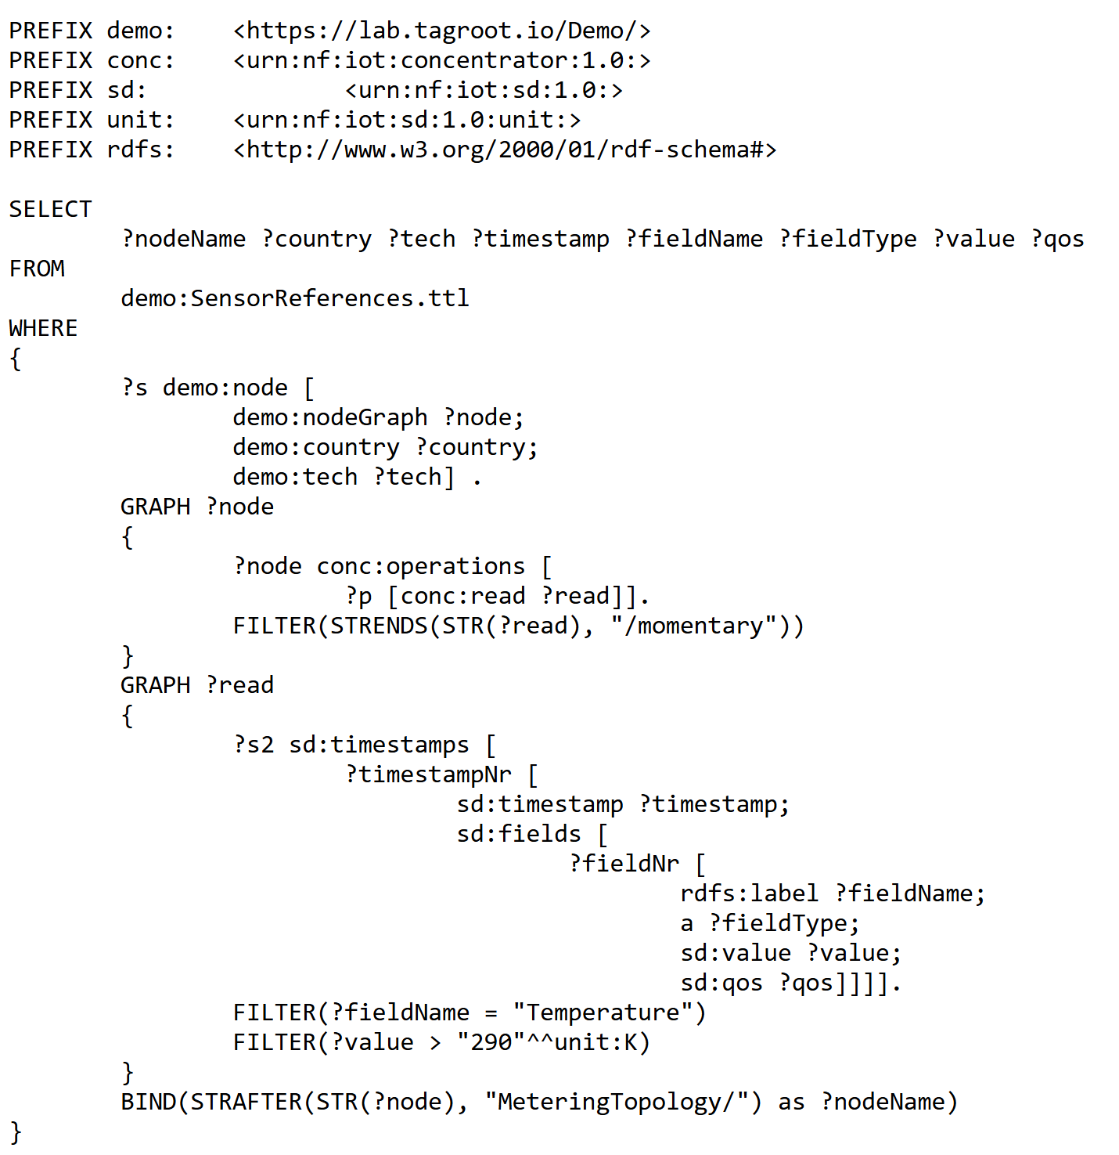
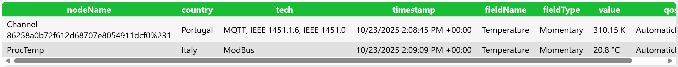
SPARQL Examples – Implicit Unit Conversion
https://lab.tagroot.io/Demo/SparqlExamples.txt
https://lab.tagroot.io/Sparql.md
https://www.w3.org/2013/data/
Notes:
```dot: Incentivising the development of the Smart City
digraph G {
bgcolor="transparent"
node [fillcolor=white,style="filled,solid"]
"cybercity.online" -> "Neuro-Foundation IoT Harmonization"
"Neuro-Foundation IoT Harmonization" [URL="#neuroFoundationIotHarmonization"]
"Neuro-Foundation IoT Harmonization" -> "Open Standards"
"Neuro-Foundation IoT Harmonization" -> "Federation"
"Neuro-Foundation IoT Harmonization" -> "Protocol Bridging"
"Open Standards" [URL="#openStandards"]
"Open Standards" -> "Interoperability"
"Protocol Bridging" [URL="#protocolBridging"]
"Protocol Bridging" -> "Interoperability"
"Federation" [URL="#federation"]
"Federation" -> "Global Identities"
"Federation" -> "Topology Independence"
"Federation" -> "Global Scalability"
"Federation" -> "Ubiquitous Encryption"
"Topology Independence" [URL="#topologyIndependence"]
"Topology Independence" -> "Resilience"
"Global Scalability" [URL="#globalScalability"]
"Global Scalability" -> "Resilience"
"Global Identities" -> "Secure Registration"
"Global Identities" -> "Authentication"
"Authentication" [URL="#authentication"]
"Authentication" -> "Consent"
"Consent" [URL="#consent"]
"Consent" -> "Authorization"
"Global Identities" [URL="#globalIdentities"]
"Global Identities" -> "Discovery"
"Discovery" [URL="#discovery"]
"Discovery" -> "Ownership"
"Ownership" [URL="#ownership"]
"Ownership" -> "Decision Support"
"Authorization" [URL="#authorization"]
"Authorization" -> "Decision Support"
"Resilience" [URL="#resilience"]
"Resilience" -> "Security"
"Secure Registration" [URL="#secureRegistration"]
"Secure Registration" -> "Security"
"Authentication" -> "Security"
"Authorization" -> "Security"
"Ubiquitous Encryption" [URL="#ubiquitousEncryption"]
"Ubiquitous Encryption" -> "Security"
"Decision Support" [URL="#decisionSupport"]
"Decision Support" -> "Security"
"Decision Support" -> "Edge Computing"
"Edge Computing" [URL="#edgeComputing"]
"Edge Computing" -> "Privacy"
"Interoperability" [URL="#interoperability"]
"Interoperability" -> "Contracts"
"Decision Support" -> "Contracts"
"Privacy" [URL="#privacy"]
"Privacy" -> "Marketplace of Things and Data"
"Security" [URL="#security"]
"Security" -> "Marketplace of Things and Data"
"Contracts" [URL="#contracts"]
"Contracts" -> "Marketplace of Things and Data"
"Marketplace of Things and Data" [URL="#marketplaceOfThingsAndData"]
"Marketplace of Things and Data" -> "Economic Feedback"
"Economic Feedback" [URL="#economicFeedback"]
"Economic Feedback" -> "Incentives to develop the Smart City"
"Incentives to develop the Smart City" [URL="#incentivesToDevelopTheSmartCity"]
}
```

Slide 22
And more…
Storing Graphs (Graph Store Protocol)
Controlling Actuators using SPARQL
Federation using SERVICE
ASK, CONSTRUCT, DESCRIBE, UPDATE, INSERT, DELETE
Integration of open data sources
…
https://www.w3.org/TR/sparql12-protocol/
https://www.w3.org/TR/sparql12-graph-store-protocol/
https://www.w3.org/2013/data/
Notes:
```dot: Incentivising the development of the Smart City
digraph G {
bgcolor="transparent"
node [fillcolor=white,style="filled,solid"]
"cybercity.online" -> "Neuro-Foundation IoT Harmonization"
"Neuro-Foundation IoT Harmonization" [URL="#neuroFoundationIotHarmonization"]
"Neuro-Foundation IoT Harmonization" -> "Open Standards"
"Neuro-Foundation IoT Harmonization" -> "Federation"
"Neuro-Foundation IoT Harmonization" -> "Protocol Bridging"
"Open Standards" [URL="#openStandards"]
"Open Standards" -> "Interoperability"
"Protocol Bridging" [URL="#protocolBridging"]
"Protocol Bridging" -> "Interoperability"
"Federation" [URL="#federation"]
"Federation" -> "Global Identities"
"Federation" -> "Topology Independence"
"Federation" -> "Global Scalability"
"Federation" -> "Ubiquitous Encryption"
"Topology Independence" [URL="#topologyIndependence"]
"Topology Independence" -> "Resilience"
"Global Scalability" [URL="#globalScalability"]
"Global Scalability" -> "Resilience"
"Global Identities" -> "Secure Registration"
"Global Identities" -> "Authentication"
"Authentication" [URL="#authentication"]
"Authentication" -> "Consent"
"Consent" [URL="#consent"]
"Consent" -> "Authorization"
"Global Identities" [URL="#globalIdentities"]
"Global Identities" -> "Discovery"
"Discovery" [URL="#discovery"]
"Discovery" -> "Ownership"
"Ownership" [URL="#ownership"]
"Ownership" -> "Decision Support"
"Authorization" [URL="#authorization"]
"Authorization" -> "Decision Support"
"Resilience" [URL="#resilience"]
"Resilience" -> "Security"
"Secure Registration" [URL="#secureRegistration"]
"Secure Registration" -> "Security"
"Authentication" -> "Security"
"Authorization" -> "Security"
"Ubiquitous Encryption" [URL="#ubiquitousEncryption"]
"Ubiquitous Encryption" -> "Security"
"Decision Support" [URL="#decisionSupport"]
"Decision Support" -> "Security"
"Decision Support" -> "Edge Computing"
"Edge Computing" [URL="#edgeComputing"]
"Edge Computing" -> "Privacy"
"Interoperability" [URL="#interoperability"]
"Interoperability" -> "Contracts"
"Decision Support" -> "Contracts"
"Privacy" [URL="#privacy"]
"Privacy" -> "Marketplace of Things and Data"
"Security" [URL="#security"]
"Security" -> "Marketplace of Things and Data"
"Contracts" [URL="#contracts"]
"Contracts" -> "Marketplace of Things and Data"
"Marketplace of Things and Data" [URL="#marketplaceOfThingsAndData"]
"Marketplace of Things and Data" -> "Economic Feedback"
"Economic Feedback" [URL="#economicFeedback"]
"Economic Feedback" -> "Incentives to develop the Smart City"
"Incentives to develop the Smart City" [URL="#incentivesToDevelopTheSmartCity"]
}
```

Slide 23
Tecnología Neuro-Ledger®
Notes:
```neato
digraph G
{
ratio=fill
size="7,7!"
bgcolor="transparent"
node [fontsize=10,width=.05,height=.05,shape=circle,style=filled,fillcolor=white]
D1 -> D2 [dir=both]
D1 -> D3 [dir=both]
D1 -> D4 [dir=both]
D1 -> D5 [dir=both]
D1 -> D6 [dir=both]
D2 -> D3 [dir=both]
D2 -> D4 [dir=both]
D2 -> D5 [dir=both]
D2 -> D6 [dir=both]
D3 -> D4 [dir=both]
D3 -> D5 [dir=both]
D3 -> D6 [dir=both]
D4 -> D5 [dir=both]
D4 -> D6 [dir=both]
D5 -> D6 [dir=both]
C11 -> D1 [dir=both]
C12 -> D1 [dir=both]
C13 -> D1 [dir=both]
C14 -> D1 [dir=both]
C21 -> D2 [dir=both]
C22 -> D2 [dir=both]
C23 -> D2 [dir=both]
C24 -> D2 [dir=both]
C31 -> D3 [dir=both]
C32 -> D3 [dir=both]
C33 -> D3 [dir=both]
C34 -> D3 [dir=both]
C41 -> D4 [dir=both]
C42 -> D4 [dir=both]
C43 -> D4 [dir=both]
C44 -> D4 [dir=both]
C51 -> D5 [dir=both]
C52 -> D5 [dir=both]
C53 -> D5 [dir=both]
C54 -> D5 [dir=both]
C61 -> D6 [dir=both]
C62 -> D6 [dir=both]
C63 -> D6 [dir=both]
C64 -> D6 [dir=both]
}
```

Slide 24
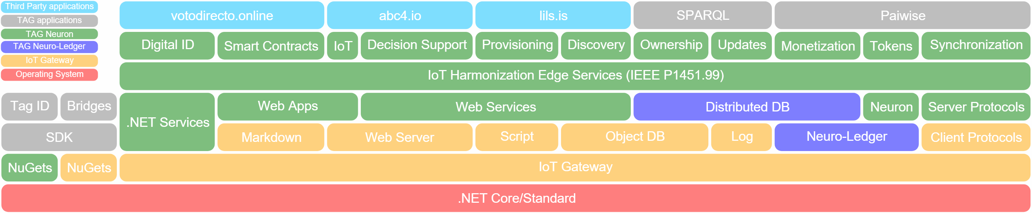
Arquitectura básica
https://lab.tagroot.io/Documentation/Index.md
Notes:
```dot: Incentivising the development of the Smart City
digraph G {
bgcolor="transparent"
node [fillcolor=white,style="filled,solid"]
"cybercity.online" -> "Neuro-Foundation IoT Harmonization"
"Neuro-Foundation IoT Harmonization" [URL="#neuroFoundationIotHarmonization"]
"Neuro-Foundation IoT Harmonization" -> "Open Standards"
"Neuro-Foundation IoT Harmonization" -> "Federation"
"Neuro-Foundation IoT Harmonization" -> "Protocol Bridging"
"Open Standards" [URL="#openStandards"]
"Open Standards" -> "Interoperability"
"Protocol Bridging" [URL="#protocolBridging"]
"Protocol Bridging" -> "Interoperability"
"Federation" [URL="#federation"]
"Federation" -> "Global Identities"
"Federation" -> "Topology Independence"
"Federation" -> "Global Scalability"
"Federation" -> "Ubiquitous Encryption"
"Topology Independence" [URL="#topologyIndependence"]
"Topology Independence" -> "Resilience"
"Global Scalability" [URL="#globalScalability"]
"Global Scalability" -> "Resilience"
"Global Identities" -> "Secure Registration"
"Global Identities" -> "Authentication"
"Authentication" [URL="#authentication"]
"Authentication" -> "Consent"
"Consent" [URL="#consent"]
"Consent" -> "Authorization"
"Global Identities" [URL="#globalIdentities"]
"Global Identities" -> "Discovery"
"Discovery" [URL="#discovery"]
"Discovery" -> "Ownership"
"Ownership" [URL="#ownership"]
"Ownership" -> "Decision Support"
"Authorization" [URL="#authorization"]
"Authorization" -> "Decision Support"
"Resilience" [URL="#resilience"]
"Resilience" -> "Security"
"Secure Registration" [URL="#secureRegistration"]
"Secure Registration" -> "Security"
"Authentication" -> "Security"
"Authorization" -> "Security"
"Ubiquitous Encryption" [URL="#ubiquitousEncryption"]
"Ubiquitous Encryption" -> "Security"
"Decision Support" [URL="#decisionSupport"]
"Decision Support" -> "Security"
"Decision Support" -> "Edge Computing"
"Edge Computing" [URL="#edgeComputing"]
"Edge Computing" -> "Privacy"
"Interoperability" [URL="#interoperability"]
"Interoperability" -> "Contracts"
"Decision Support" -> "Contracts"
"Privacy" [URL="#privacy"]
"Privacy" -> "Marketplace of Things and Data"
"Security" [URL="#security"]
"Security" -> "Marketplace of Things and Data"
"Contracts" [URL="#contracts"]
"Contracts" -> "Marketplace of Things and Data"
"Marketplace of Things and Data" [URL="#marketplaceOfThingsAndData"]
"Marketplace of Things and Data" -> "Economic Feedback"
"Economic Feedback" [URL="#economicFeedback"]
"Economic Feedback" -> "Incentives to develop the Smart City"
"Incentives to develop the Smart City" [URL="#incentivesToDevelopTheSmartCity"]
}
```

Slide 25
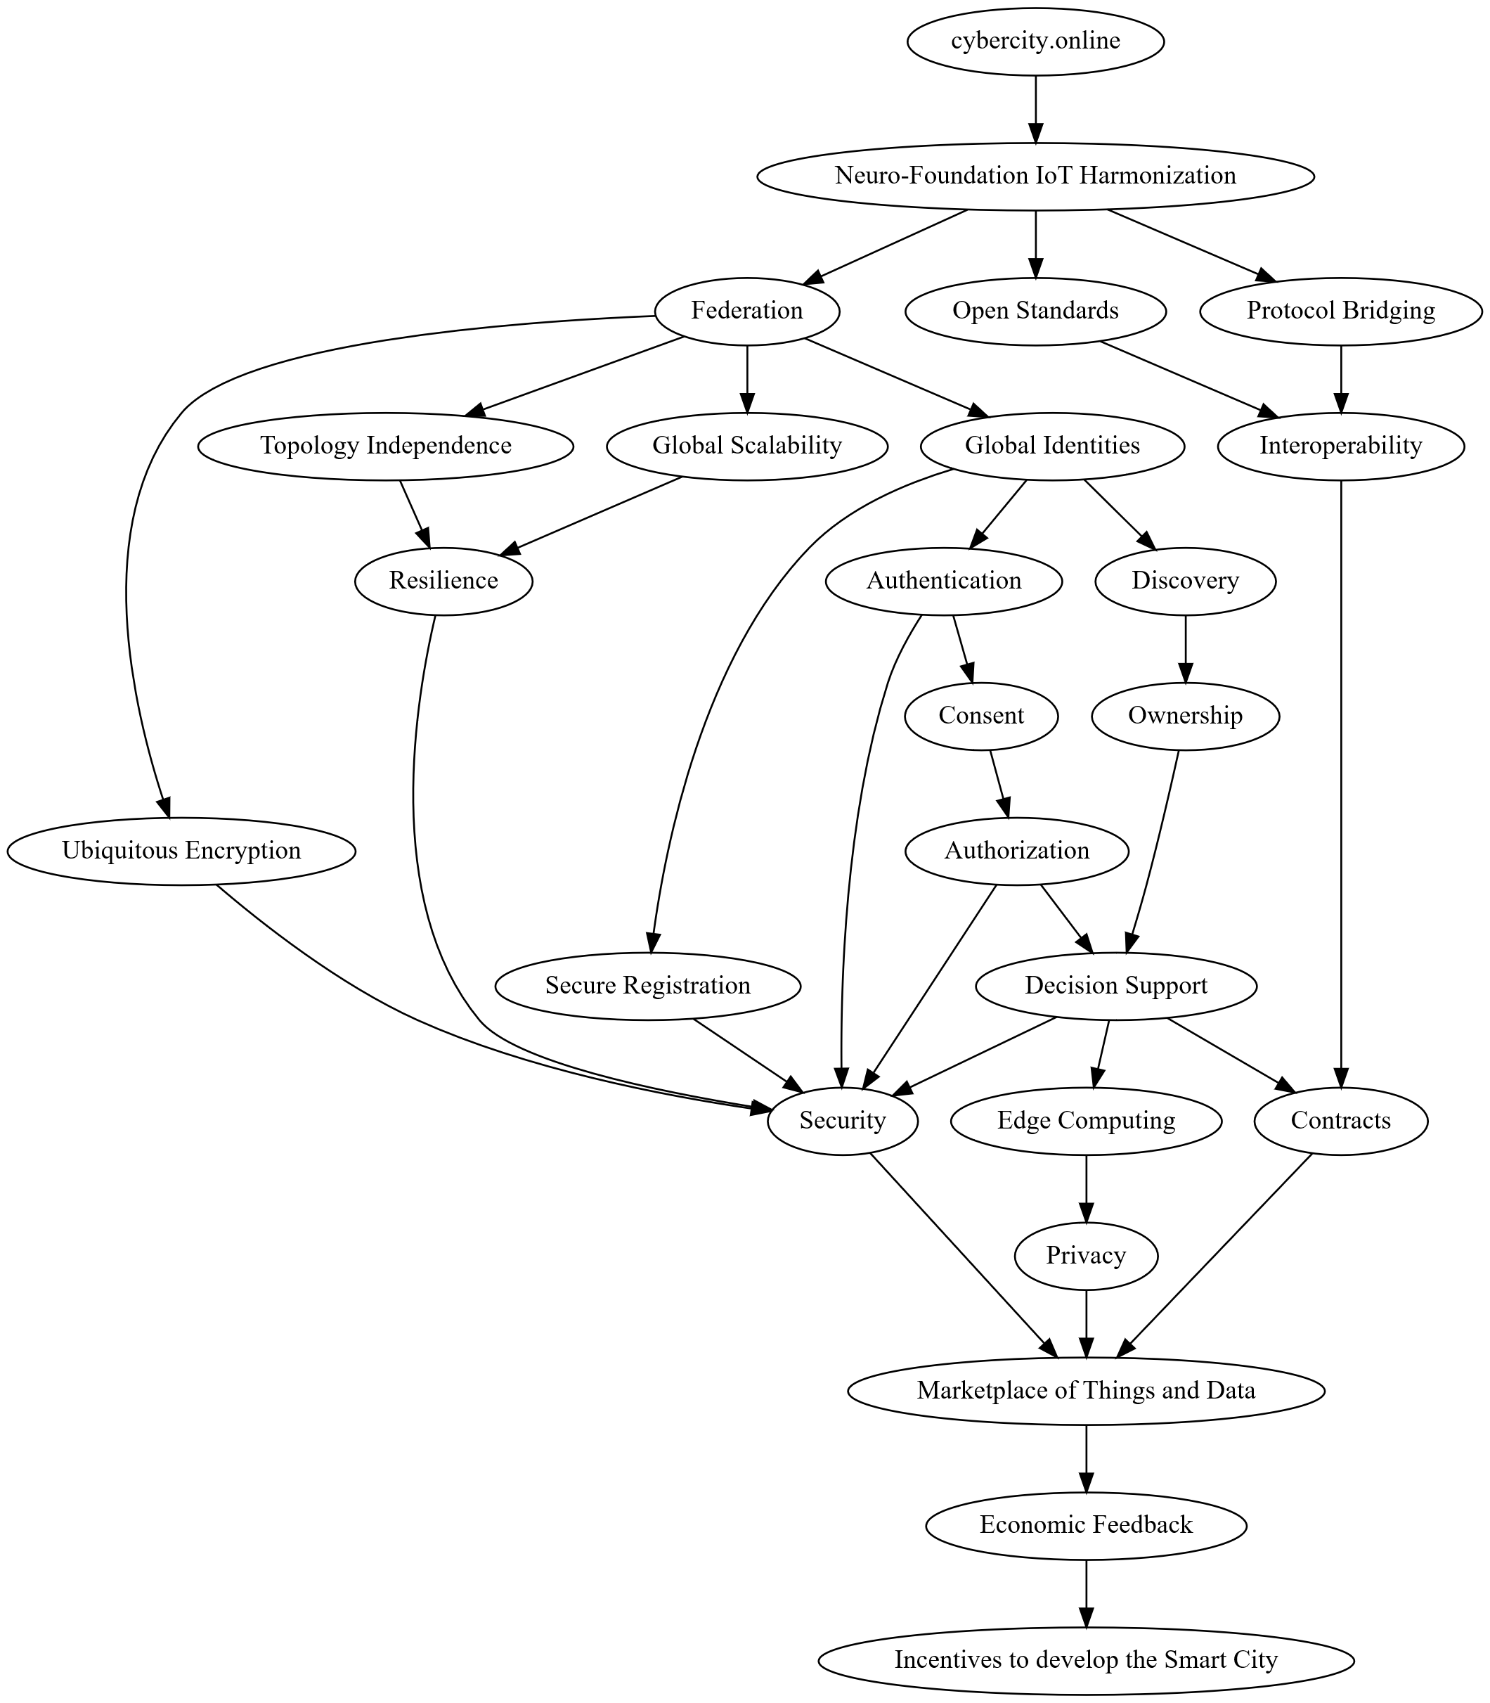

CyberCity.Online
Financiado por IIS (Asociación de Internet.se)
Estándar para la sociedad inteligente
Para Cosas (IoT)
Para Humanos
Global
Independiente de tecnologías (armonización)
Privacidad
Ciberseguridad
Monetización
https://cybercity.online/
Notes:
```dot: Incentivising the development of the Smart City
digraph G {
bgcolor="transparent"
node [fillcolor=white,style="filled,solid"]
"cybercity.online" -> "Neuro-Foundation IoT Harmonization"
"Neuro-Foundation IoT Harmonization" [URL="#neuroFoundationIotHarmonization"]
"Neuro-Foundation IoT Harmonization" -> "Open Standards"
"Neuro-Foundation IoT Harmonization" -> "Federation"
"Neuro-Foundation IoT Harmonization" -> "Protocol Bridging"
"Open Standards" [URL="#openStandards"]
"Open Standards" -> "Interoperability"
"Protocol Bridging" [URL="#protocolBridging"]
"Protocol Bridging" -> "Interoperability"
"Federation" [URL="#federation"]
"Federation" -> "Global Identities"
"Federation" -> "Topology Independence"
"Federation" -> "Global Scalability"
"Federation" -> "Ubiquitous Encryption"
"Topology Independence" [URL="#topologyIndependence"]
"Topology Independence" -> "Resilience"
"Global Scalability" [URL="#globalScalability"]
"Global Scalability" -> "Resilience"
"Global Identities" -> "Secure Registration"
"Global Identities" -> "Authentication"
"Authentication" [URL="#authentication"]
"Authentication" -> "Consent"
"Consent" [URL="#consent"]
"Consent" -> "Authorization"
"Global Identities" [URL="#globalIdentities"]
"Global Identities" -> "Discovery"
"Discovery" [URL="#discovery"]
"Discovery" -> "Ownership"
"Ownership" [URL="#ownership"]
"Ownership" -> "Decision Support"
"Authorization" [URL="#authorization"]
"Authorization" -> "Decision Support"
"Resilience" [URL="#resilience"]
"Resilience" -> "Security"
"Secure Registration" [URL="#secureRegistration"]
"Secure Registration" -> "Security"
"Authentication" -> "Security"
"Authorization" -> "Security"
"Ubiquitous Encryption" [URL="#ubiquitousEncryption"]
"Ubiquitous Encryption" -> "Security"
"Decision Support" [URL="#decisionSupport"]
"Decision Support" -> "Security"
"Decision Support" -> "Edge Computing"
"Edge Computing" [URL="#edgeComputing"]
"Edge Computing" -> "Privacy"
"Interoperability" [URL="#interoperability"]
"Interoperability" -> "Contracts"
"Decision Support" -> "Contracts"
"Privacy" [URL="#privacy"]
"Privacy" -> "Marketplace of Things and Data"
"Security" [URL="#security"]
"Security" -> "Marketplace of Things and Data"
"Contracts" [URL="#contracts"]
"Contracts" -> "Marketplace of Things and Data"
"Marketplace of Things and Data" [URL="#marketplaceOfThingsAndData"]
"Marketplace of Things and Data" -> "Economic Feedback"
"Economic Feedback" [URL="#economicFeedback"]
"Economic Feedback" -> "Incentives to develop the Smart City"
"Incentives to develop the Smart City" [URL="#incentivesToDevelopTheSmartCity"]
}
```

Slide 26
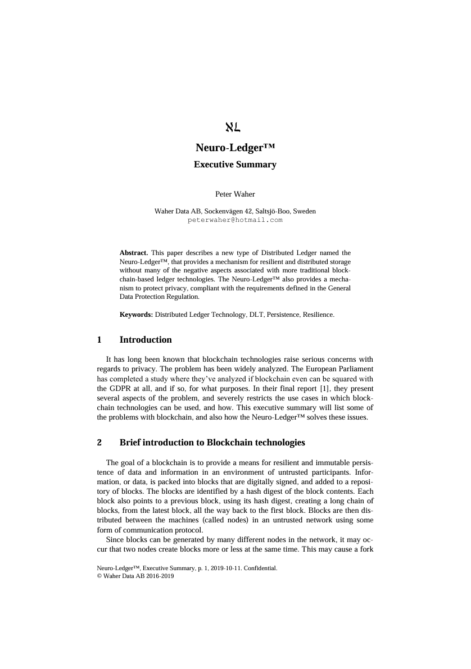
Neuro-Ledger®
Redes de confianza basado en neuronas interconectadas.
Identificación fuerte
Federación y gobernanza local
Registro distribuido, DLT
Trazabilidad, integridad, soberanía digital.
Auditabilidad y Transparencia.
Privacidad, cumplimiento con GDPR.
Criptografía post-cuántica (ML-KEM, ML-DSA).
Escalable, en acceso y resiliencia, y contenido.
Sostenible
https://neuro-foundation.io/Papers/Neuro-Ledger,%20Executive%20Summary.pdf

Slide 27
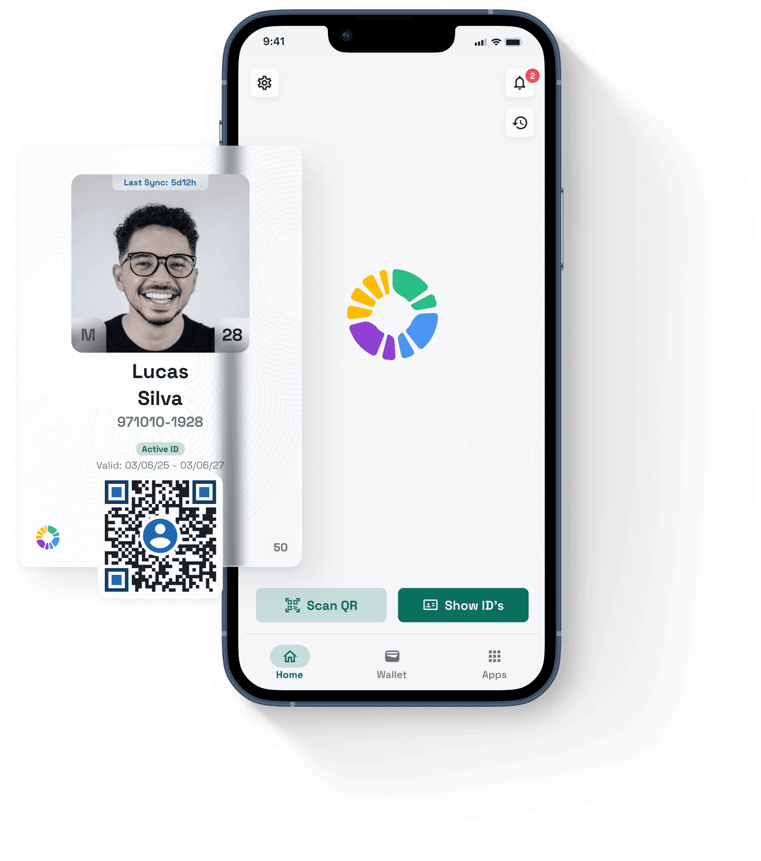
Neuro-Access™
Identidad Digital Soberana.
Billetera para activos digitales.
Firmas digitales.
Single-Sign-On (Quick-Login™)
Autentificación
Aplicaciones Distribuidas.
Proveedores de Confianza – Notarius Electrónicus.
White-Label
Código Abierto
https://www.neuro-tech.io/guides/access
https://neuro-foundation.io/Papers/Notarius%20Electronicus.pdf

Slide 28
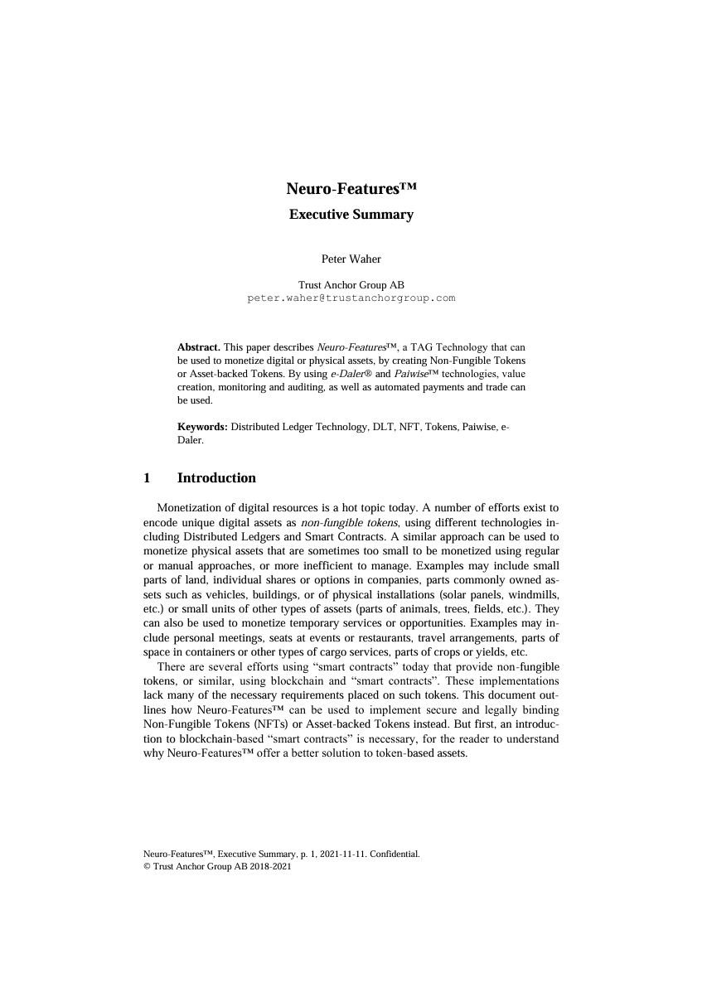
Neuro-Features™
Contratos Inteligentes, que son ambos contractos e inteligentes.
Leíble para humanos y para maquinas.
Mecanismo de control de integridad y contexto legal.
Ciclo de vida.
Patrones, Partes, Roles, Parámetros.
Privacidad, consentimiento y autorización para acceso.
Tokenización de bienes reales.
Pagamentos programables.
Automatización y comunicación cros-dominio.
https://neuro-foundation.io/Papers/Neuro-Features,%20Executive%20Summary.pdf

Slide 29
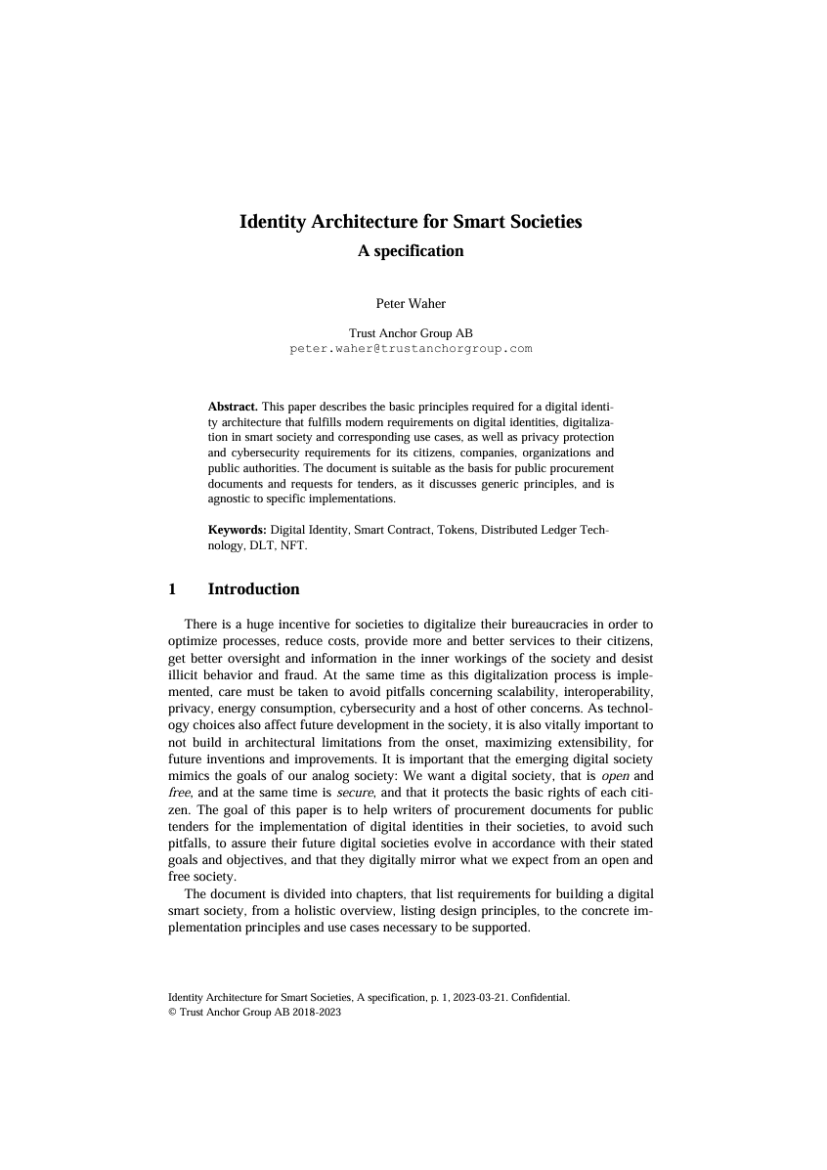
Neuro-Foundation™
Interoperación
Federación
Ciberseguridad
Harmonización de Internet de las Cosas
Sistemas Ciber-físicos (CPS)
Propiedad de información
Monetización
https://neuro-foundation.io/
https://neuro-foundation.io/Papers/Identity%20Architecture%20for%20Smart%20Societies.pdf

Slide 30
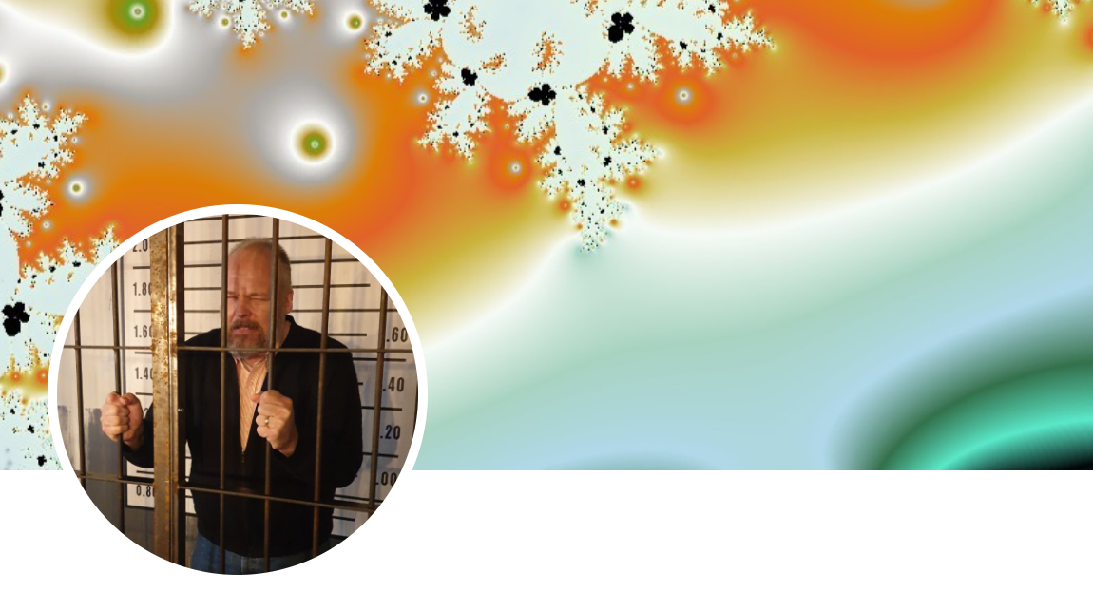
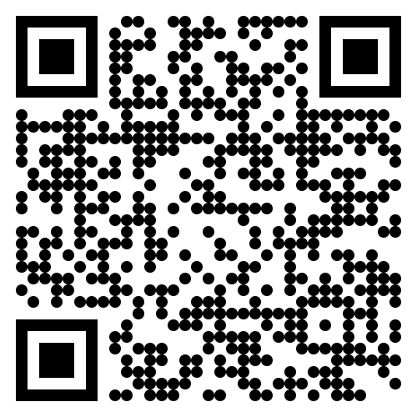
Questions?
?

